Slide 1
Health Awareness and Nutrition
Hypertension and Cardiovascular Diseases
Department of Clinical Nutrition and Dietetics
College of Health Sciences

Slide 2
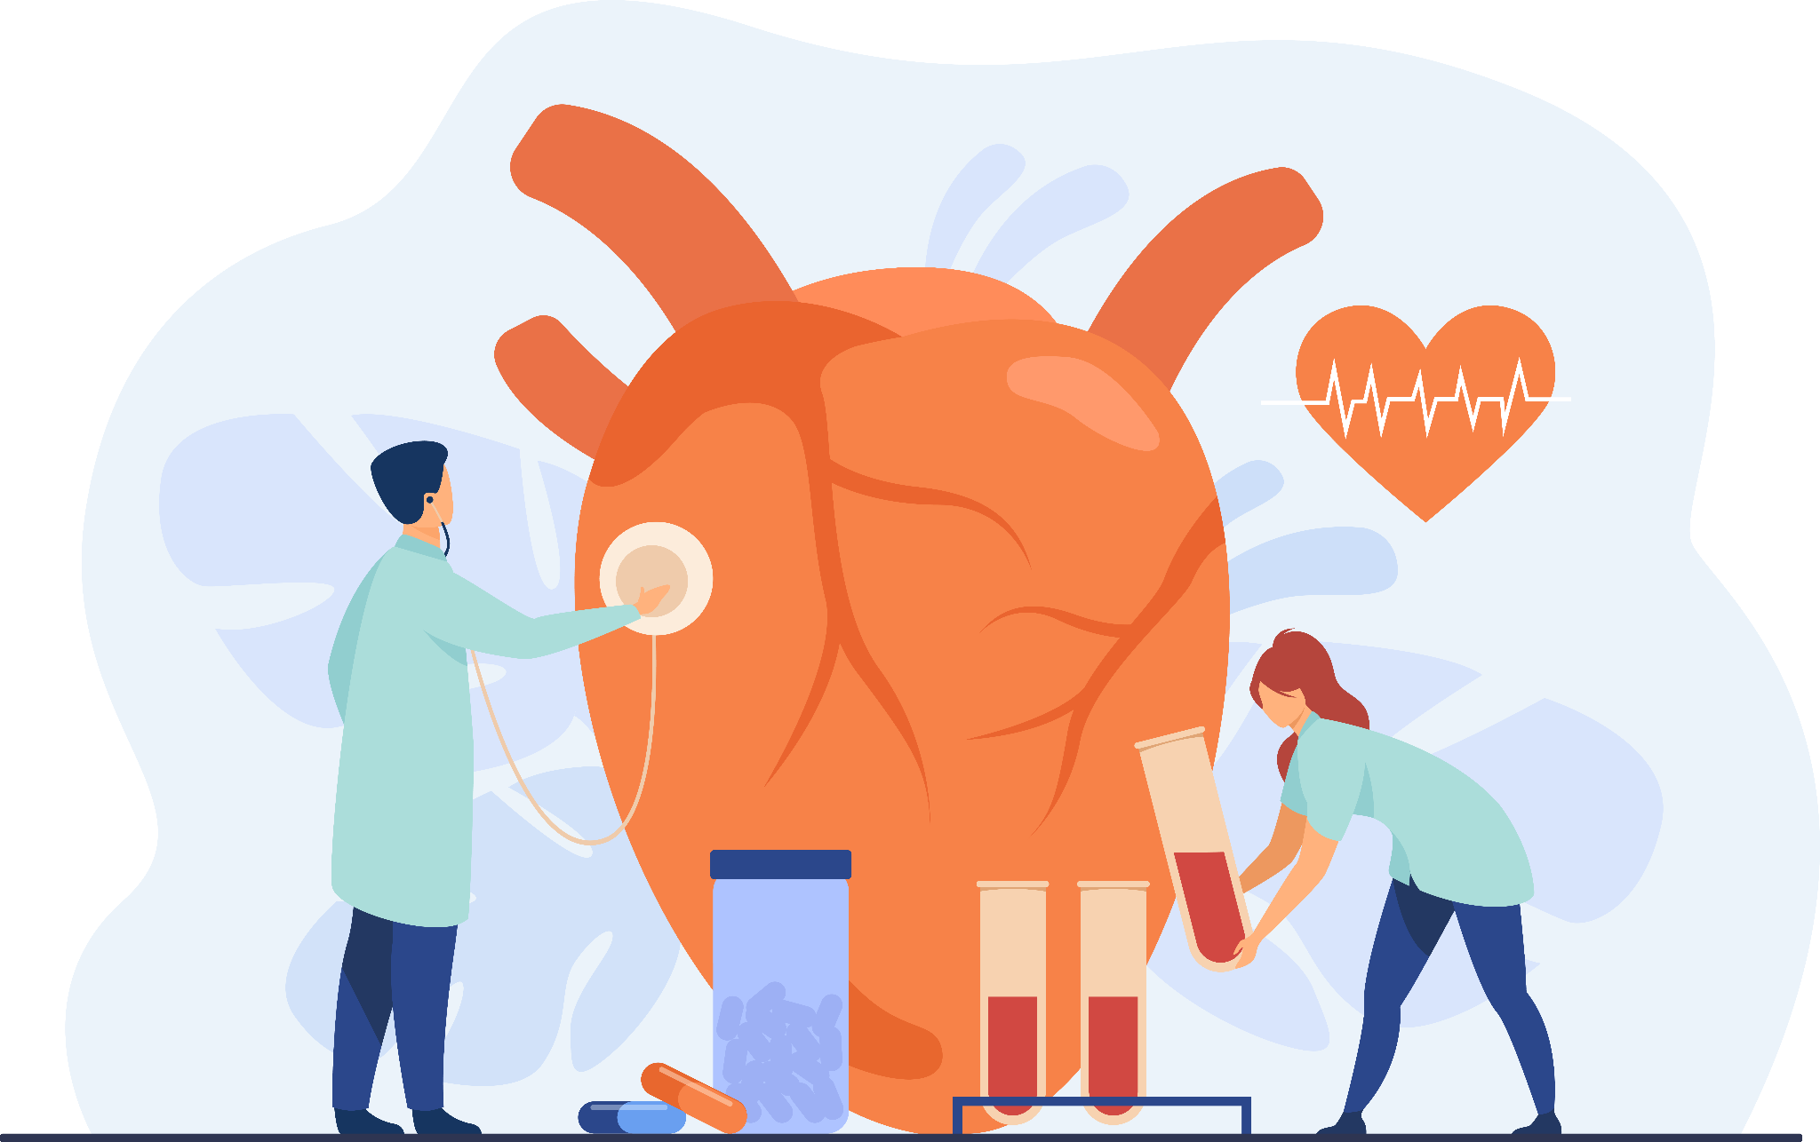
Hypertension and
Cardiovascular Diseases
Cardiovascular disease (CVD) remains the number one killer, claiming 18.6 million lives globally every year.
33% of all deaths are from CVD.
Risk factors such as diet, smoking, and air pollution, can have a significant impact on people’s cardiovascular health.

Slide 3

Hypertension
Nearly 1 in 2 adults have high blood pressure.
Without treatment, high blood pressure can damage the arteries, heart, kidneys, and other organs.
It can lead to heart attacks, strokes, and kidney failure.
It can also cause vision and memory loss.

Slide 4
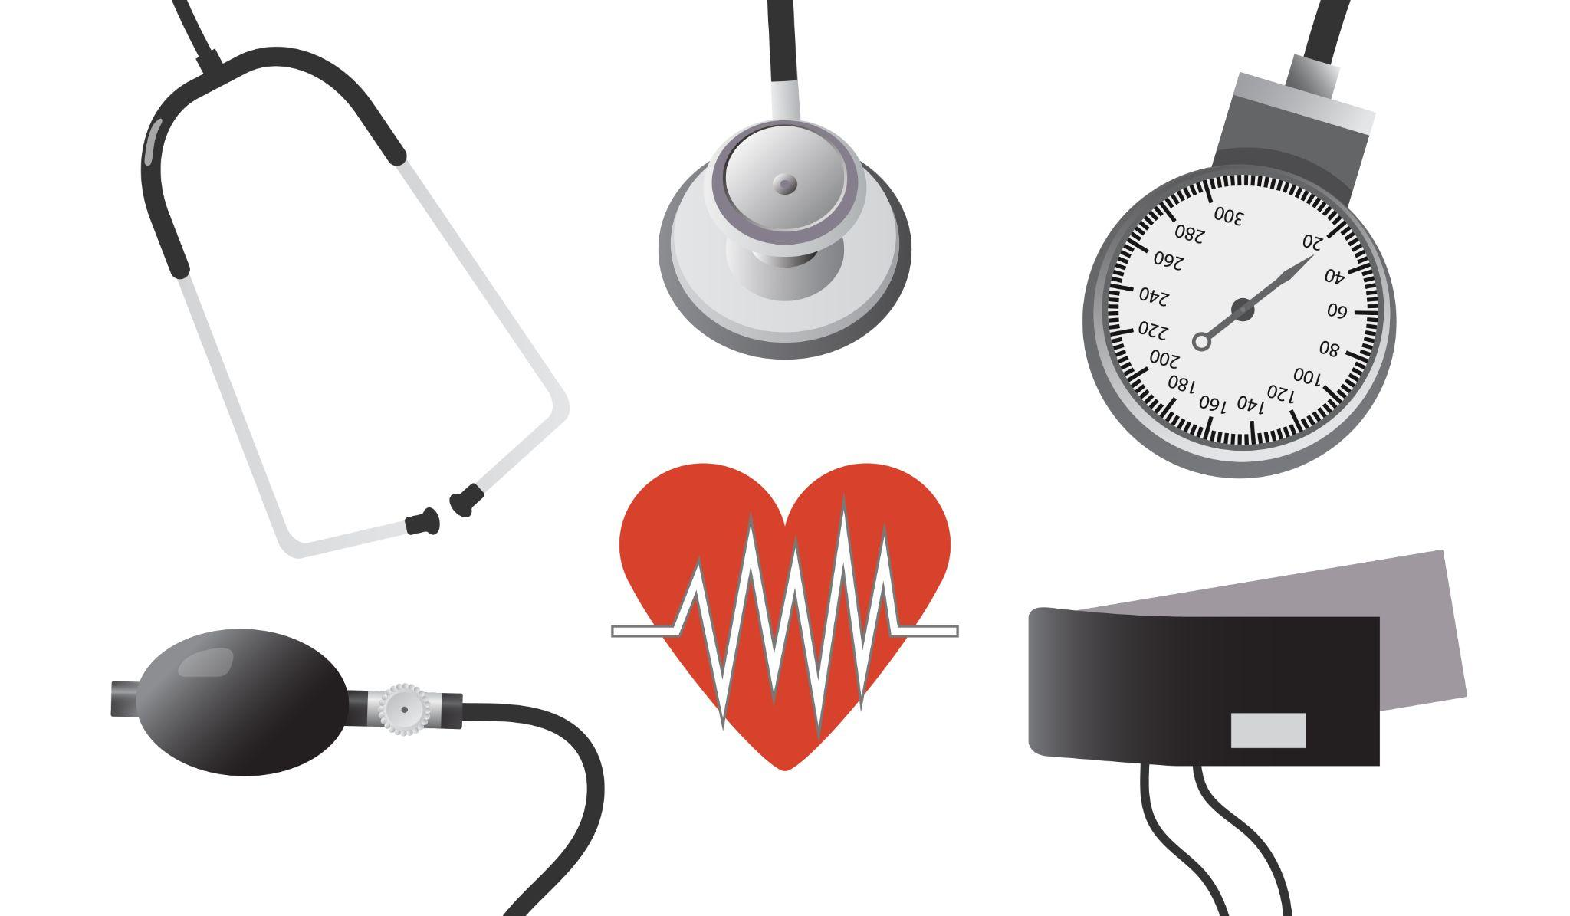
Hypertension
It is defined as sustained elevated arterial blood pressure (continued increased blood pressure in the arteries).
Instrument used:
Sphygmomanometer – it measures:
Systolic Blood Pressure (SBP)
Diastolic Blood Pressure (DBP)

Slide 5
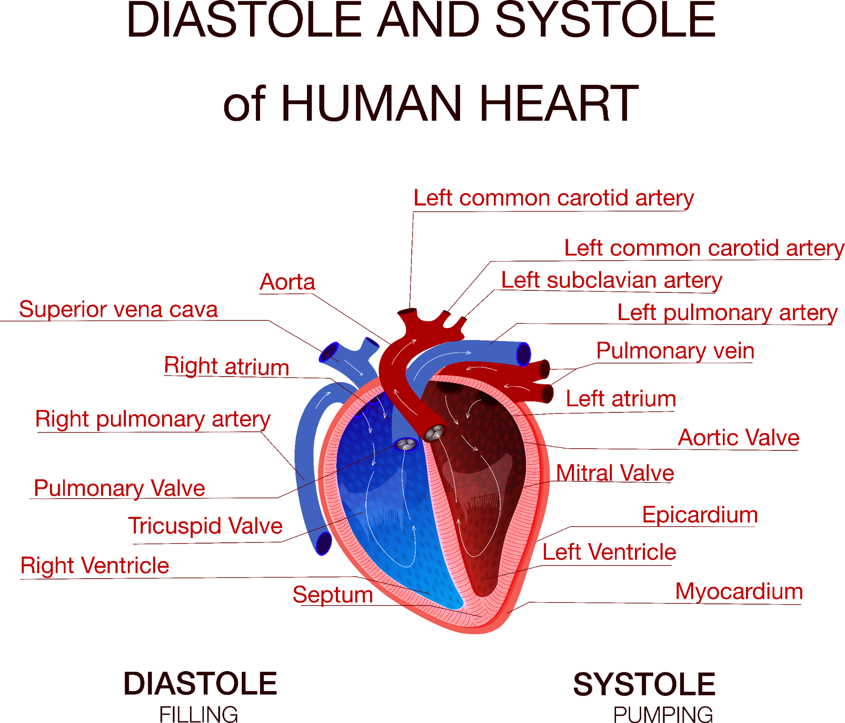
Hypertension
Systolic: The phase of blood circulation in which the heart's pumping chambers (ventricles) are actively pumping blood.
Diastolic: The phase of blood circulation in which the heart's pumping chambers (ventricles) are being filled with blood.
Normal BP: Less than 120/80 mm Hg.
High blood pressure increases the risk of heart disease and kidney disease.

Slide 6
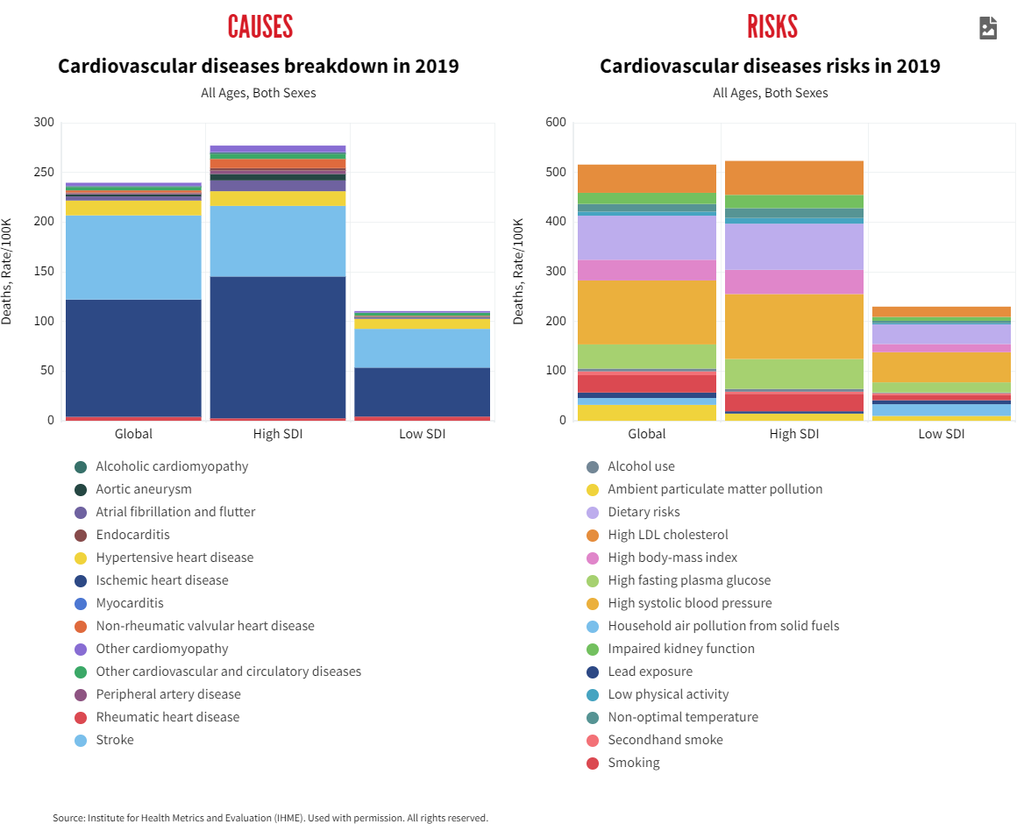

Slide 7
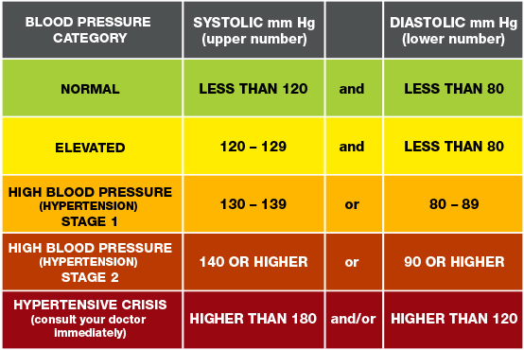
Classification of Blood Pressure

Slide 8
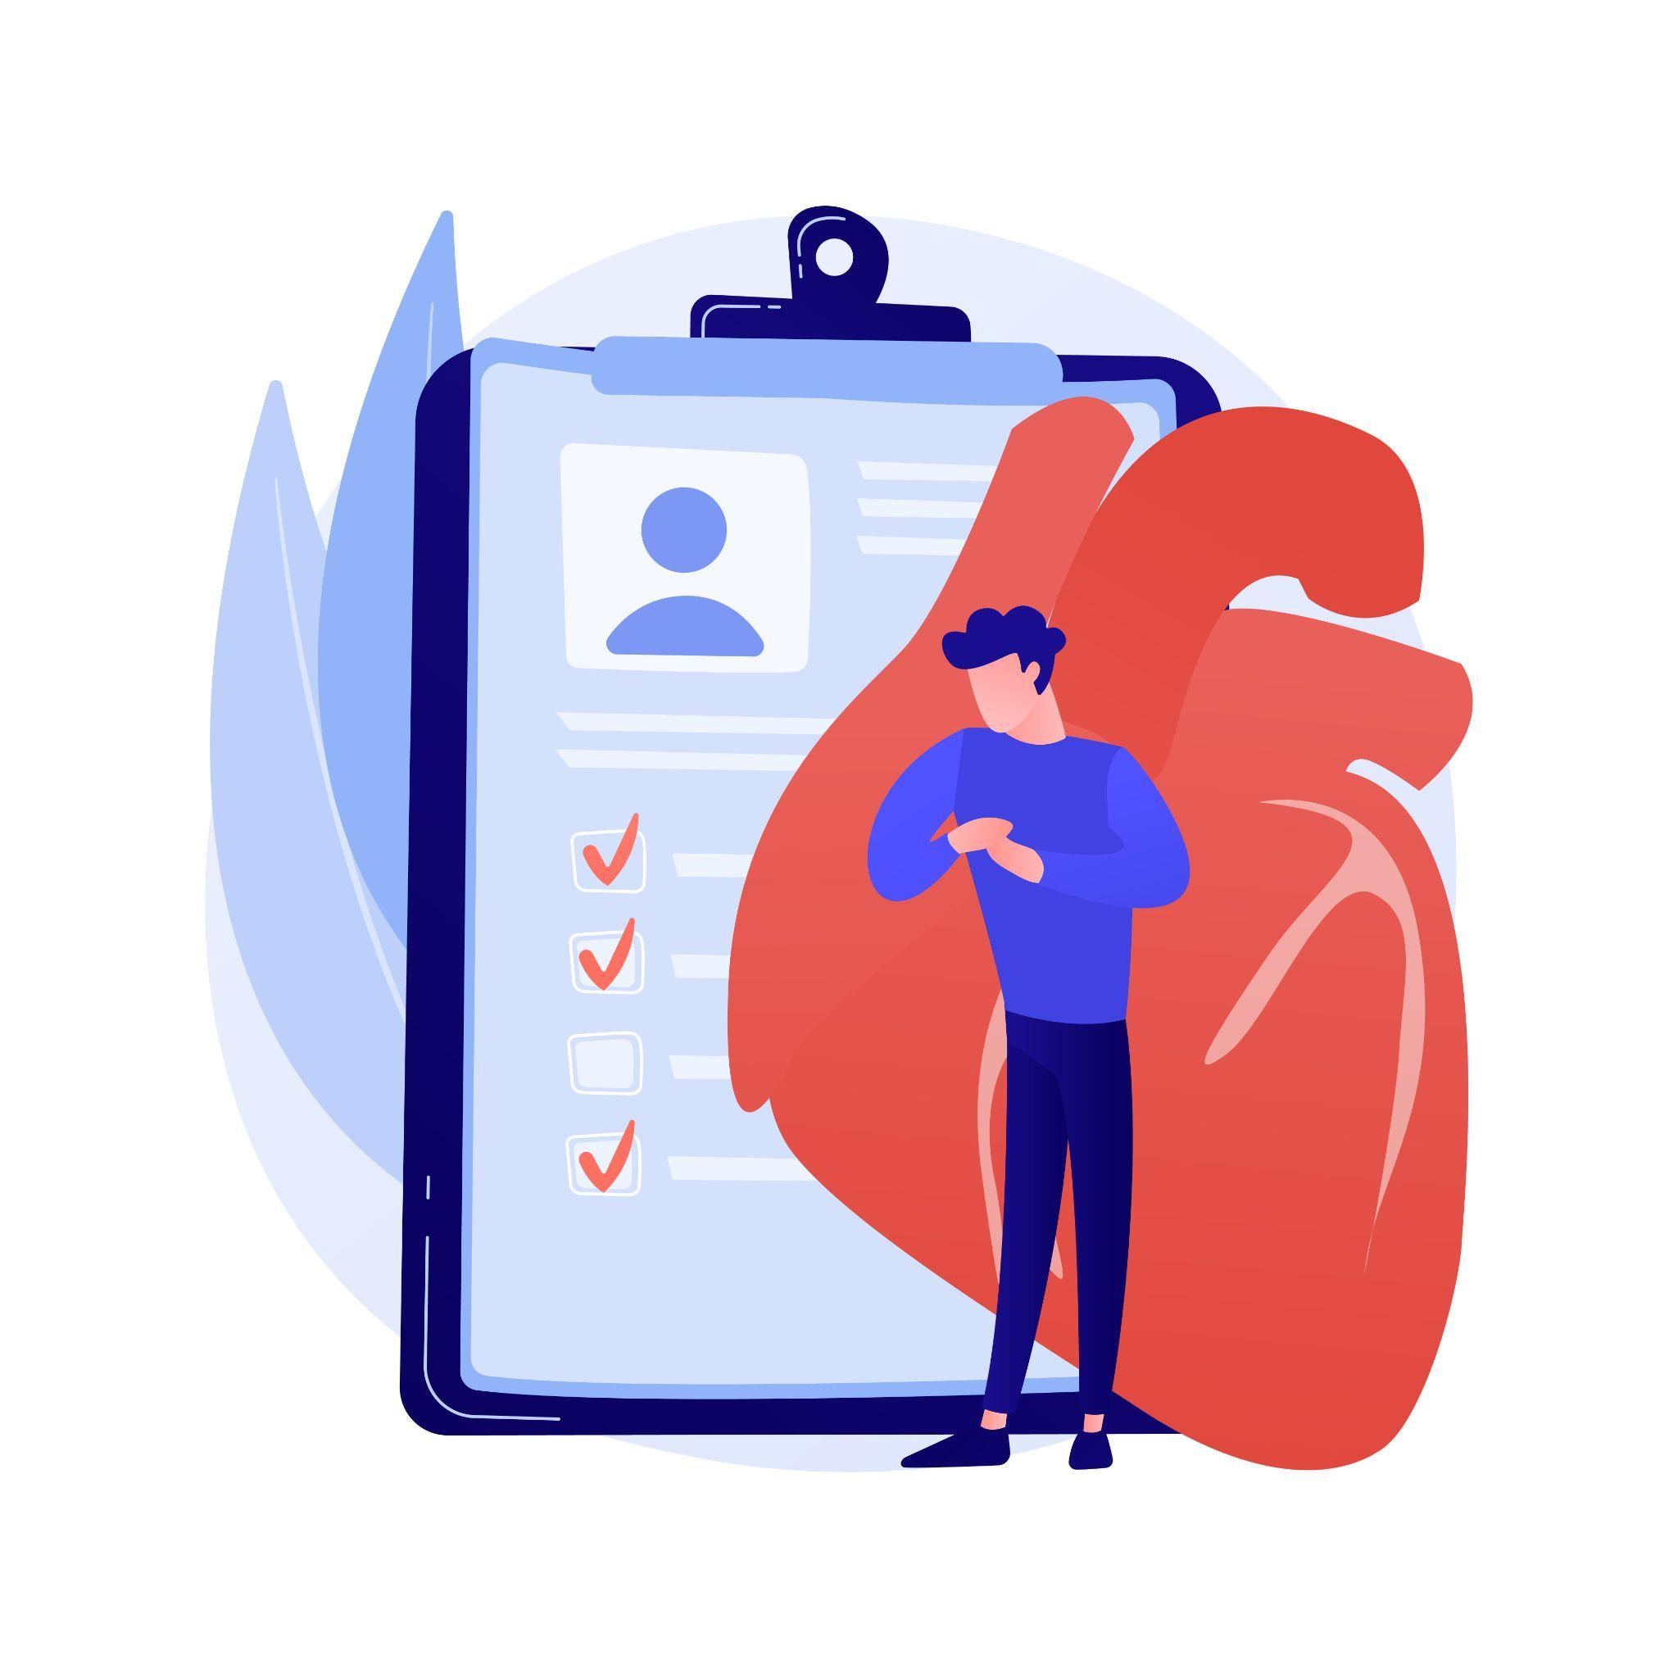
Types of Hypertension
Primary/essential (cause not known) in the majority of cases of hypertension (about 95%).
Secondary to other diseases:
Kidney diseases
Hormonal diseases
Oral contraceptives in women

Slide 9
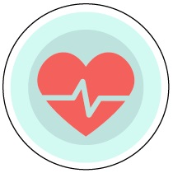
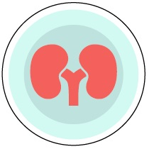
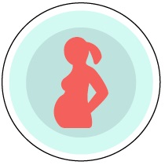
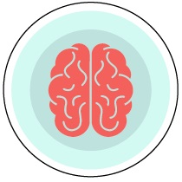
Consequences of Hypertension
If left uncontrolled, high blood pressure can increase a person’s risk for heart disease, stroke, heart failure, kidney disease, pregnancy complications, and cognitive decline later in life.
Has no warning signs or symptoms.

Slide 10
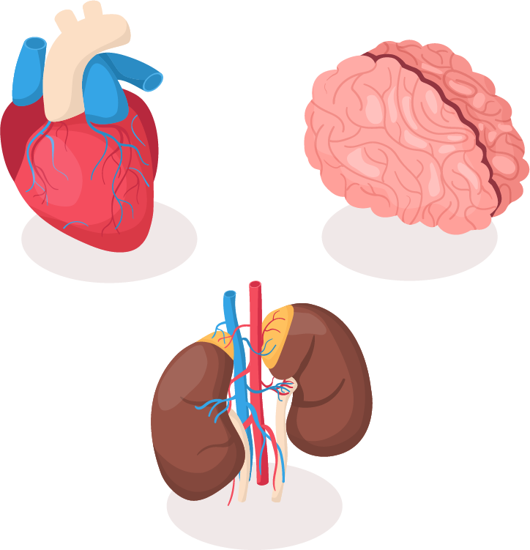
Untreated Hypertension
Target organs that are damaged:
Heart – heart disease
Brain - cerebrovascular disease
Kidneys - renal disease
Arteries - large vessel disease
Notes:
These are the reasons we want to get hypertension under control. It greatly increases the risk of chronic disease and there are higher health care costs associated with these diseases.
People with uncontrolled hypertension are:
3x more likely to develop coronary heart disease.
6x more likely to develop congestive heart failure
7x more likely to have a stroke
Heart disease is still the number one killer and stroke is still the number 3 killer in United States. (Cancer is number 2).
High blood pressure is a major risk factor for both.
Prevention is key. Your risk never goes back to where it was. Under the best of circumstances, a treated patient still has twice the risk of heart attack or stroke of someone who never had high blood pressure.

Slide 11
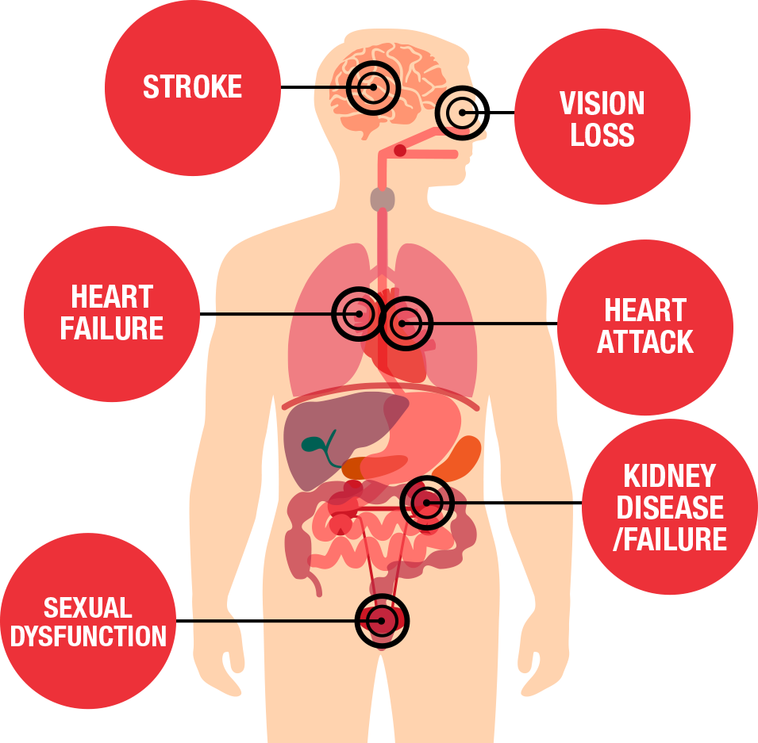
High Blood Pressure and CVD
Makes the heart work too hard.
Increases the pressure on the walls of arteries and can cause hardening of arteries.
If left untreated, can cause heart failure, kidney disease, and blindness.
Increases risk for heart disease and stroke.
Notes:
Most people with high blood pressure have no signs or symptoms, even if blood pressure readings reach dangerously high levels. HBP can lead to headaches, being tired all the time, blurred vision, nosebleeds, ringing in the ears, chest pain, irregular heartbeat, feeling of confusion off and on and heart failure. Very high blood pressure, if untreated, could eventually lead to heart attack or stroke.

Slide 12
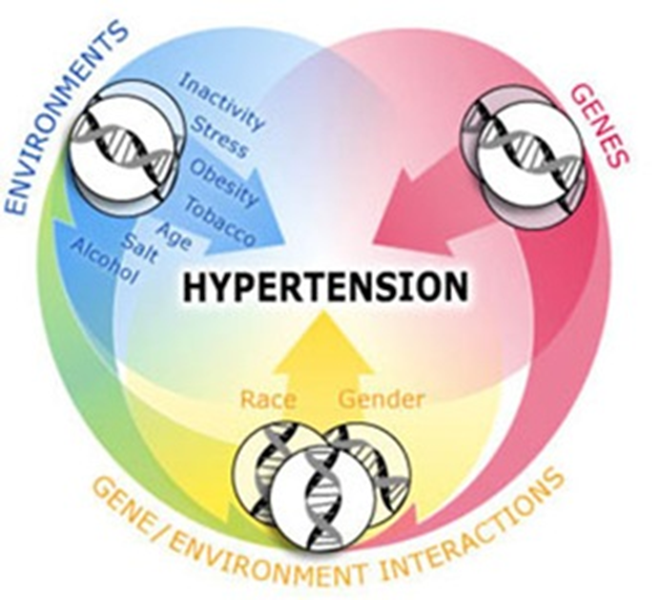
Risk Factors
Non-Modifiable:
Age
Race/ethnicity
Gender
Family history
Modifiable:
Overweight
Abnormal lipid metabolism
Smoking
Physical inactivity
Unhealthy diet
Excessive alcohol intake
Notes:
Who Is at Risk for High Blood Pressure?
High blood pressure (HBP) is a common condition. In the United States, about 1 in 3 adults has HBP.
Certain traits, conditions, and habits—known as risk factors—can raise your risk for HBP. The major risk factors for HBP are described below.
Older Age: Blood pressure tends to rise with age. If you're a male older than 45 or a female older than 55, you're at increased risk for HBP. Over half of all Americans aged 60 and older have HBP.
Isolated systolic hypertension (ISH) is the most common form of HBP in older adults. ISH occurs when only systolic blood pressure (the top number) is high. About 2 out of 3 people over age 60 with HBP have ISH.
HBP doesn't have to be a routine part of aging. You can take steps to keep your blood pressure at a normal level. (For more information, go to "How Is High Blood Pressure Treated?")
Race/Ethnicity: HBP can affect anyone. However, it's more common in African American adults than in Caucasian or Hispanic American adults. In relation to these groups, African Americans: Tend to get HBP earlier in life, Often have more severe HBP, Are more likely to be aware that they have HBP and to get treatment, Are less likely than Caucasians and about as likely as Hispanic Americans to achieve target control levels with HBP treatment, Have higher rates than Caucasians of early death from HBP-related problems, such as coronary heart disease, stroke, and kidney failure.
HBP risks vary among different groups of Hispanic American adults. For instance, Puerto Rican American adults have higher rates of HBP-related death than all other Hispanic groups and Caucasians. However, Cuban Americans have lower rates of HBP-related death than Caucasians.
Overweight or Obesity: You're more likely to develop prehypertension or HBP if you're overweight or obese. The terms "overweight" and "obesity" refer to body weight that's greater than what is considered healthy for a certain height.
Gender: Fewer adult women have HBP than adult men. But, younger women (aged 18–59) are more likely than men to be aware of and get treatment for HBP. Women aged 60 and older are as likely as men to be aware of and treated for HBP. However, among treated women aged 60 and older, blood pressure control is lower than it is in men in the same age group.
Family History: A family history of HBP raises your risk for the condition. Long-lasting stress also can put you at risk for HBP.
Modifiable risk factors: Abnormal blood lipid levels, that is high total cholesterol, high levels of triglycerides, high levels of low-density lipoprotein or low levels of high-density lipoprotein (HDL) cholesterol all increase the risk of heart disease and stroke. Changing to a healthy diet, exercise and medication can modify your blood lipid profile.
Tobacco use, whether it is smoking or chewing tobacco, increases risks of cardiovascular disease. The risk is especially high if you started smoking when young, smoke heavily or are a woman. Passive smoking is also a risk factor for cardiovascular disease. Stopping tobacco use can reduce your risk of cardiovascular disease significantly, no matter how long you have smoked.
Physical inactivity increases the risk of heart disease and stroke by 50%. Obesity is a major risk for cardiovascular disease and predisposes you to diabetes. Diabetes is a risk factor for cardiovascular disease.
A diet high in saturated fat increases the risk of heart disease and stroke. It is estimated to cause about 31% of coronary heart disease and 11% of stroke worldwide.
Having one to two alcohol drinks a day may lead to a 30% reduction in heart disease, but above this level alcohol consumption will damage the heart muscle.

Slide 13
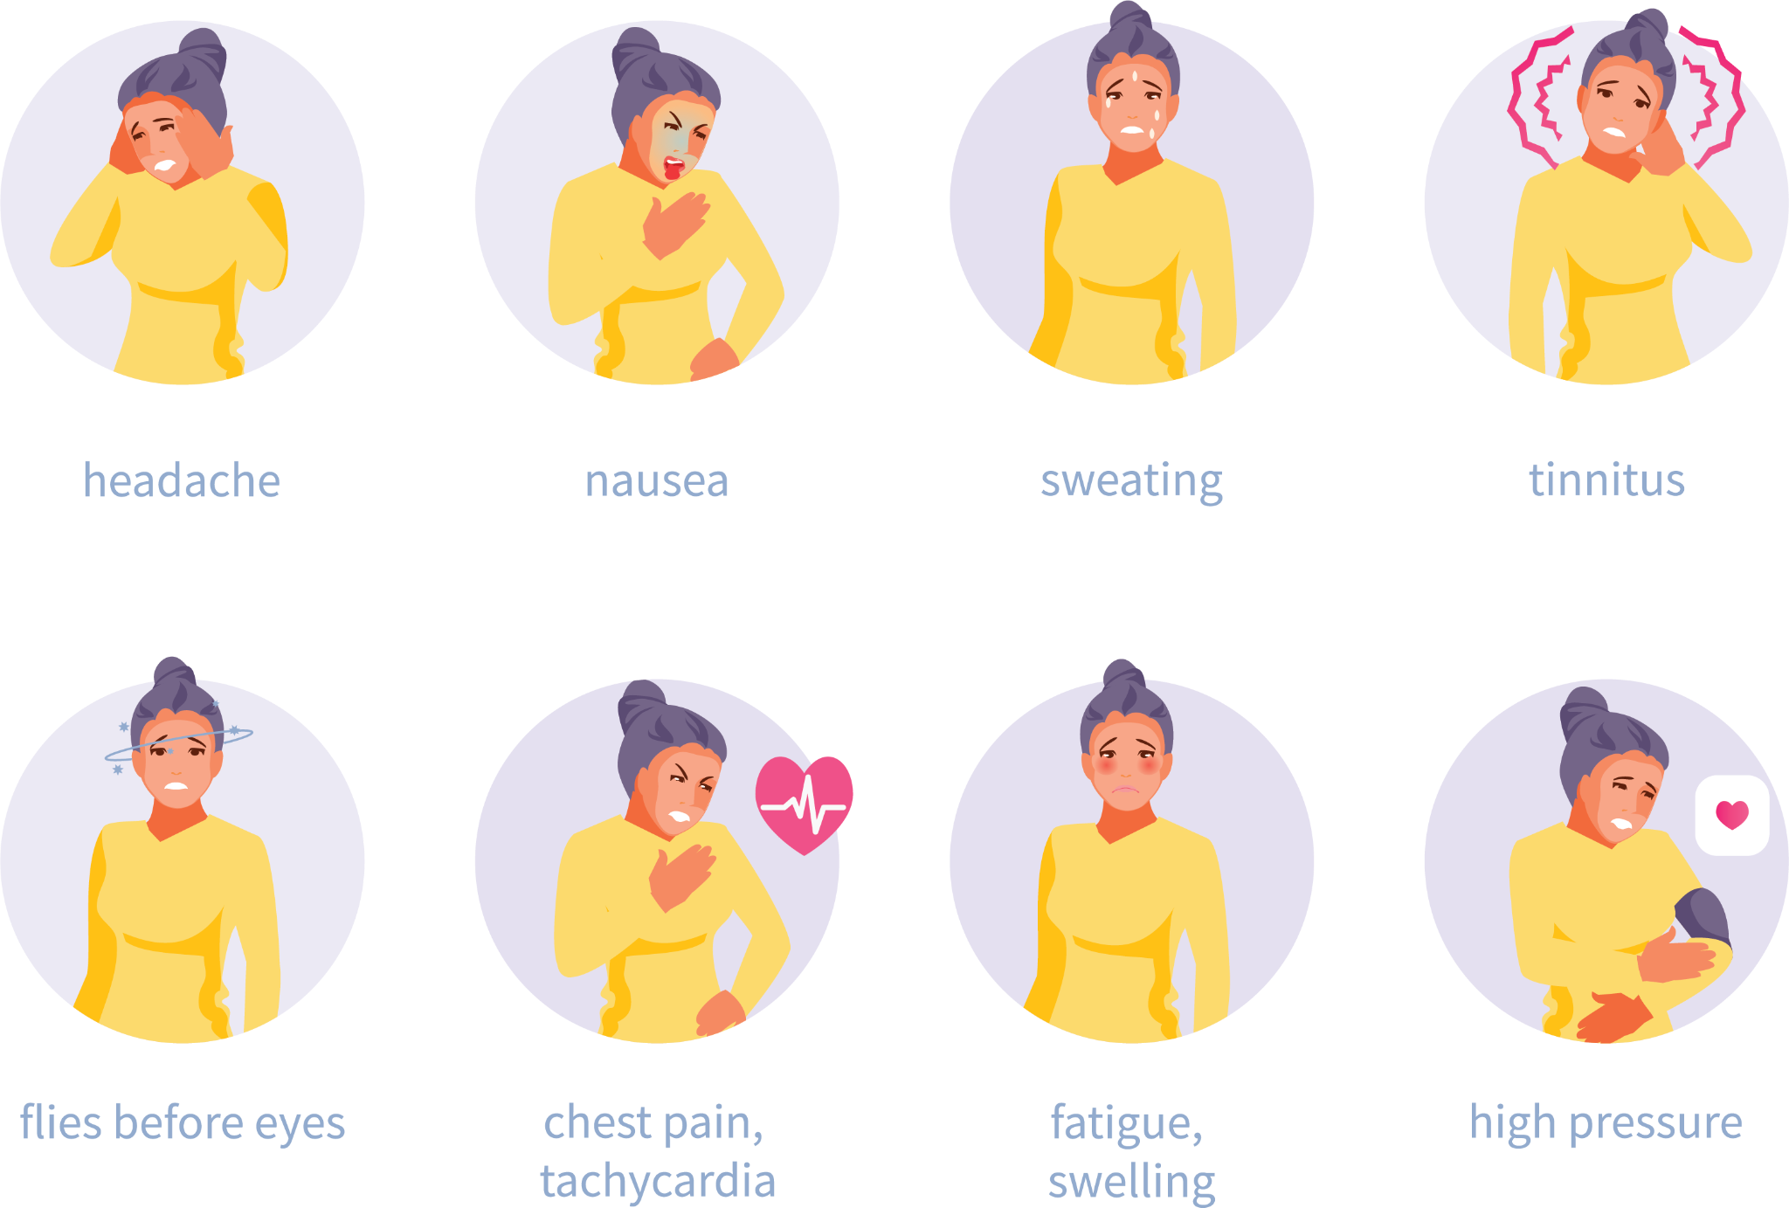
Clinical Symptoms
Headache, edema (swelling in extremities) and proteinuria (presence of protein in urine).
Other symptoms:
Dizziness, Impaired vision
Failing memory, shortness of breath
Pain, gastrointestinal disturbances

Slide 14
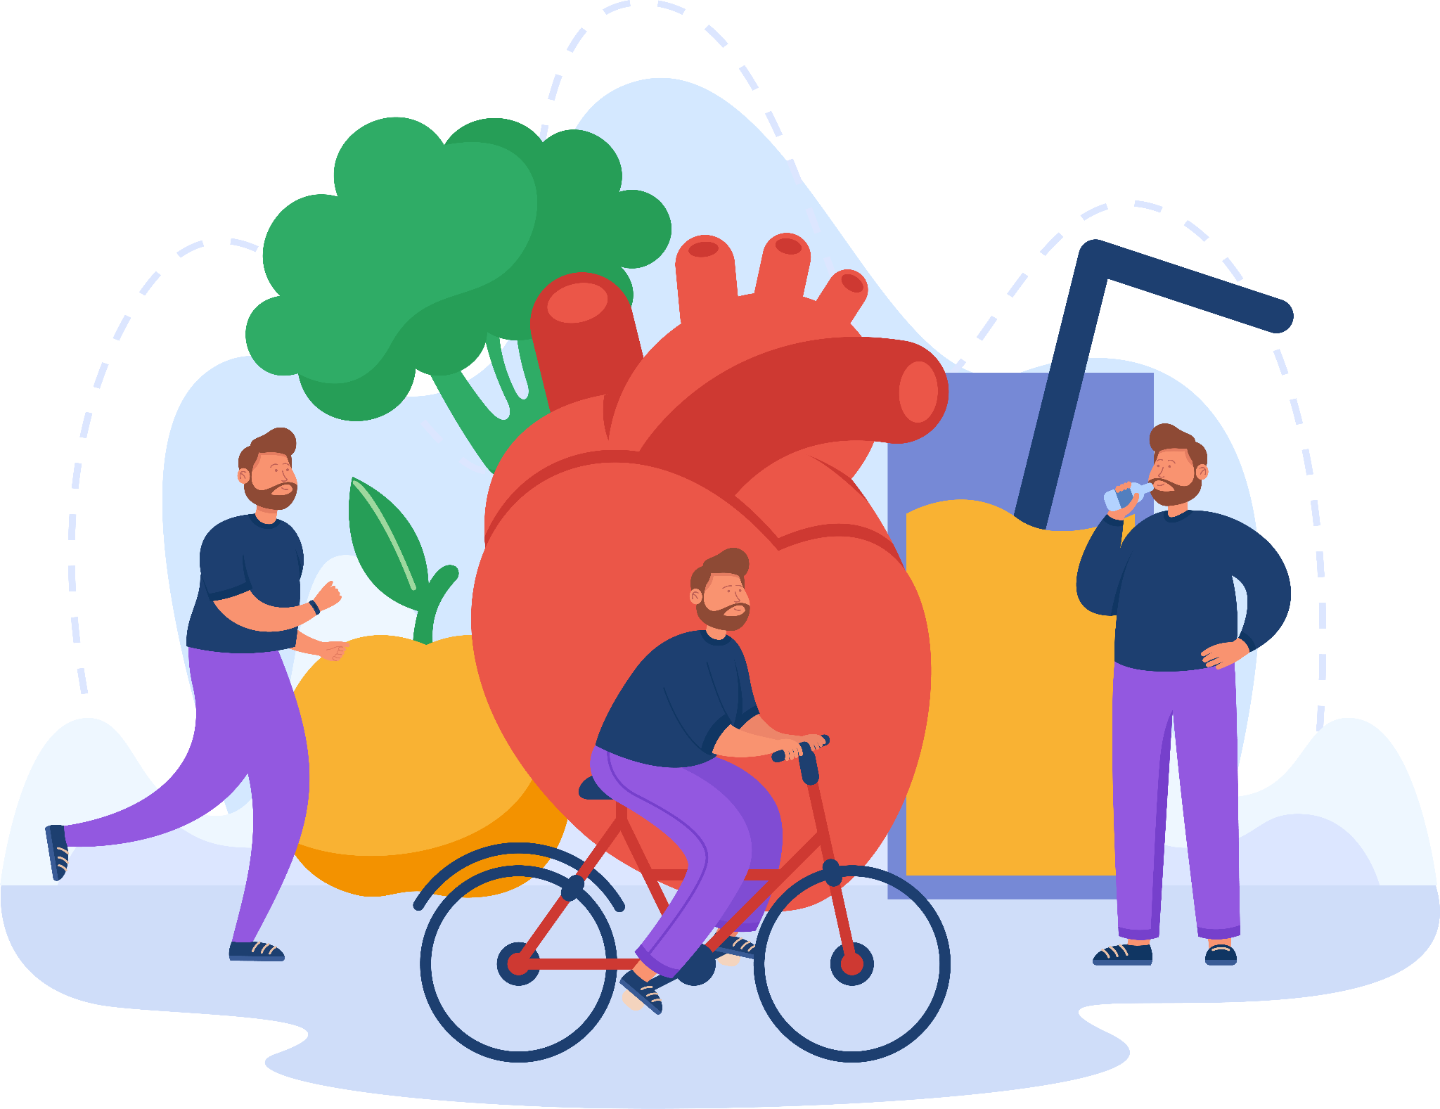
Dietary Management
Objectives:
To achieve and maintain desirable body weight
To reduce sodium intake
To increase potassium intake
To maintain adequate nutrition

Slide 15
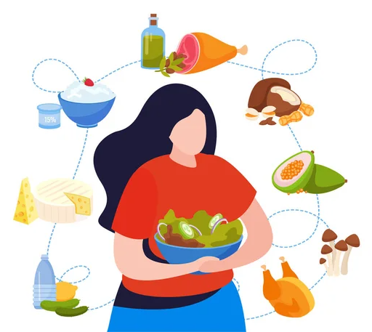
Diet and Hypertension
Non-pharmacological way of treating hypertension.
DASH Diet (Dietary Approaches to Stop Hypertension):
High in whole grains, fruits, vegetables, and low-fat dairy
Adequate Calcium, Potassium, Magnesium
Low in red meat, sweets and sugar beverages
Low in saturated and trans fat, cholesterol
Notes:
Non-pharmacological way of treating hypertension.
DASH diet (Dietary Approaches to Stop Hypertension):
High in whole grains, fruits, vegetables, and low-fat dairy
Adequate Calcium, Potassium, Magnesium
Low in red meat, sweets and sugar beverages
Low in saturated and trans fat, cholesterol
The DASH diet is physician-recommended for people with hypertension (high blood pressure) or prehypertension. The DASH diet eating plan has been proven to lower blood pressure in studies sponsored by the National Institutes of Health (Dietary Approaches to Stop Hypertension). In addition to being a low salt (or low sodium) plan, the DASH diet provides additional benefits to reduce blood pressure. It is based on an eating plan rich in fruits and vegetables, and low-fat or non-fat dairy, with whole grains. It is a high fiber, low to moderate fat diet, and is rich in potassium, calcium, and magnesium. The DASH diet is a healthy plan, designed for the whole family. New research continues to show additional health benefits of the plan.
In addition to being recommended by your physician, DASH is also endorsed by:
The National Heart, Lung, and Blood Institute (one of the National Institutes of Health, of the US Department of Health and Human Services)
The American Heart Association
The 2010 Dietary Guidelines for Americans
US guidelines for treatment of high blood pressure and the DASH diet formed the basis for the USDA MyPyramid.

Slide 16
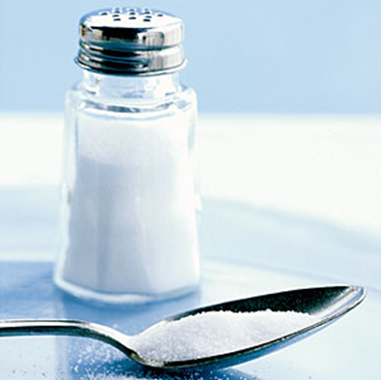
Eat Less Sodium
Reduce sodium to less than 2400 milligrams per day.
Most of the sodium in our diet comes from salt, or sodium chloride.
Salt is about 40% sodium.

Slide 17
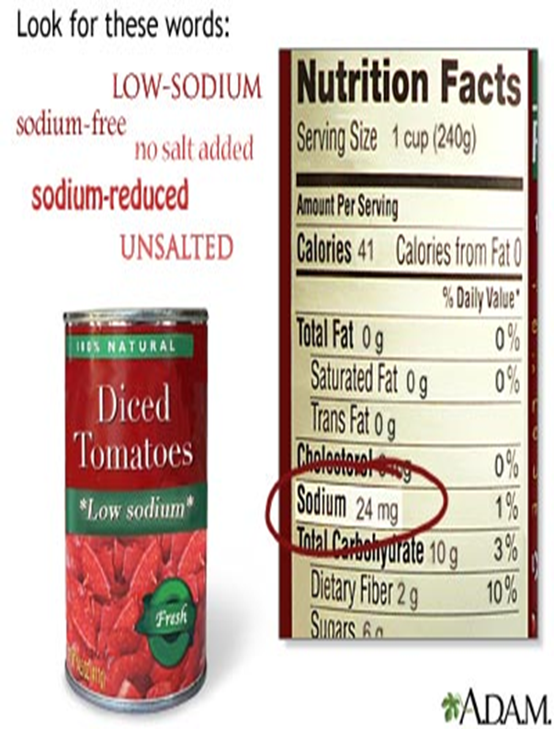
Eat Less Sodium
Look for “low sodium” or “salt free” – watch “reduced sodium.”
Choose more foods with Daily Value less than 10%.

Slide 18
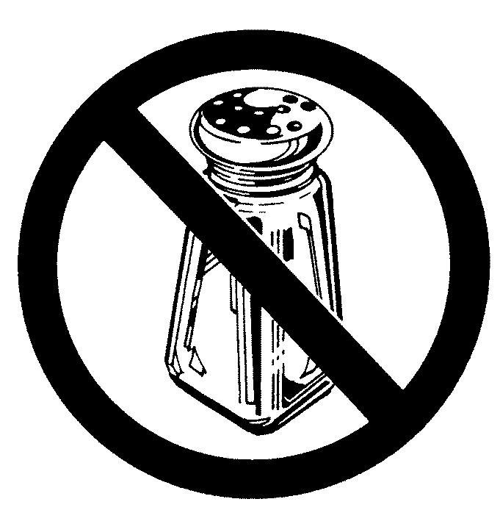
Ways To Cut Sodium
Remove salt shaker.
Add little if any salt to cooking.
Buy more fresh or plain frozen “no added salt” veggies.
Use more herbs and spices.

Slide 19
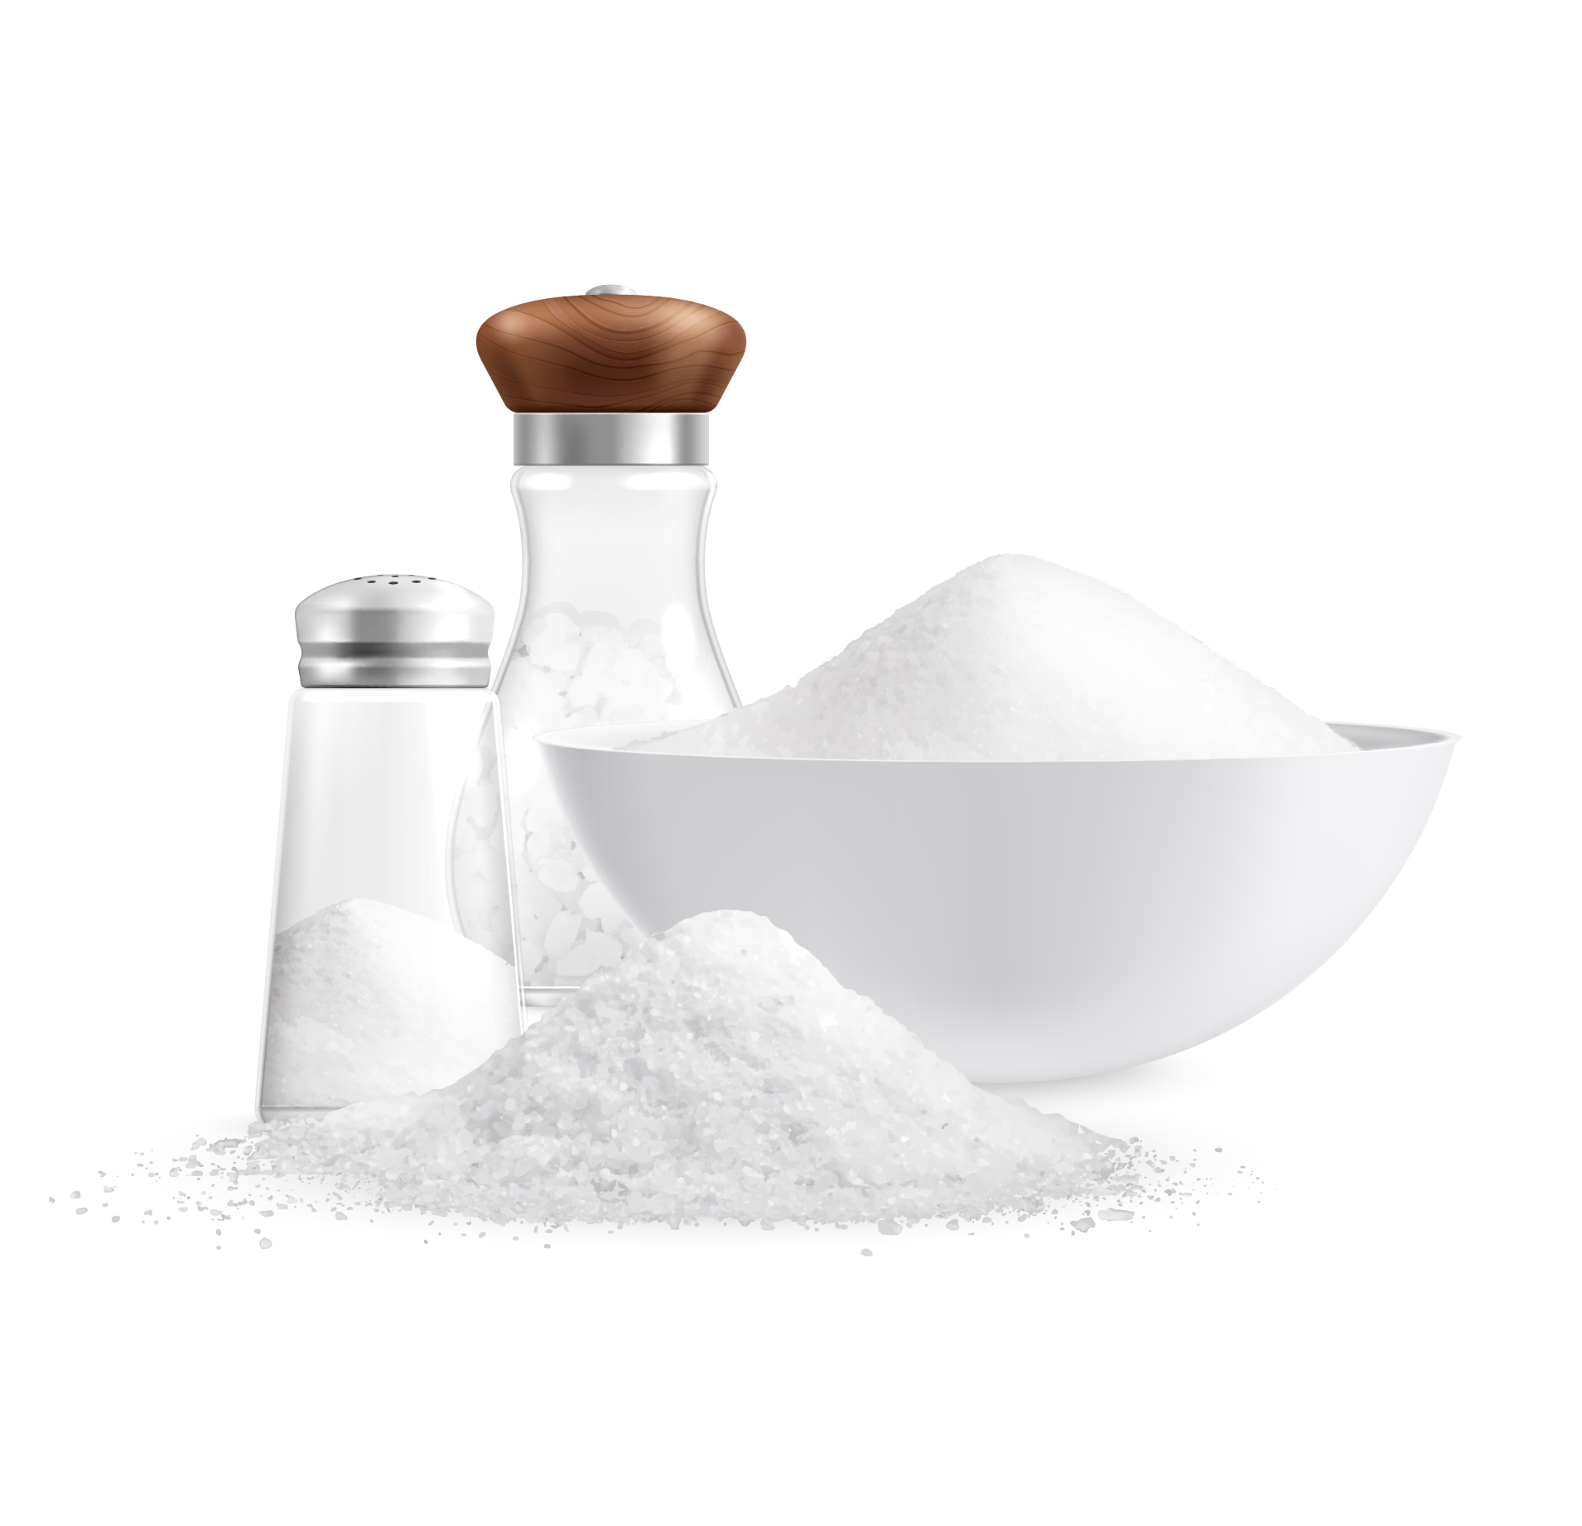
Sodium Restricted Diets
Sodium (Na) Restricted Diets:
The success of controlling hypertension lies in an appropriate intake of sodium level.
Levels of Na restriction per day are:
Mild sodium restriction: 2000-3000 mg
Extreme sodium restriction: 200-300 mg
Sodium (Na) = 40% of salt (NaCl) molecule

Slide 20
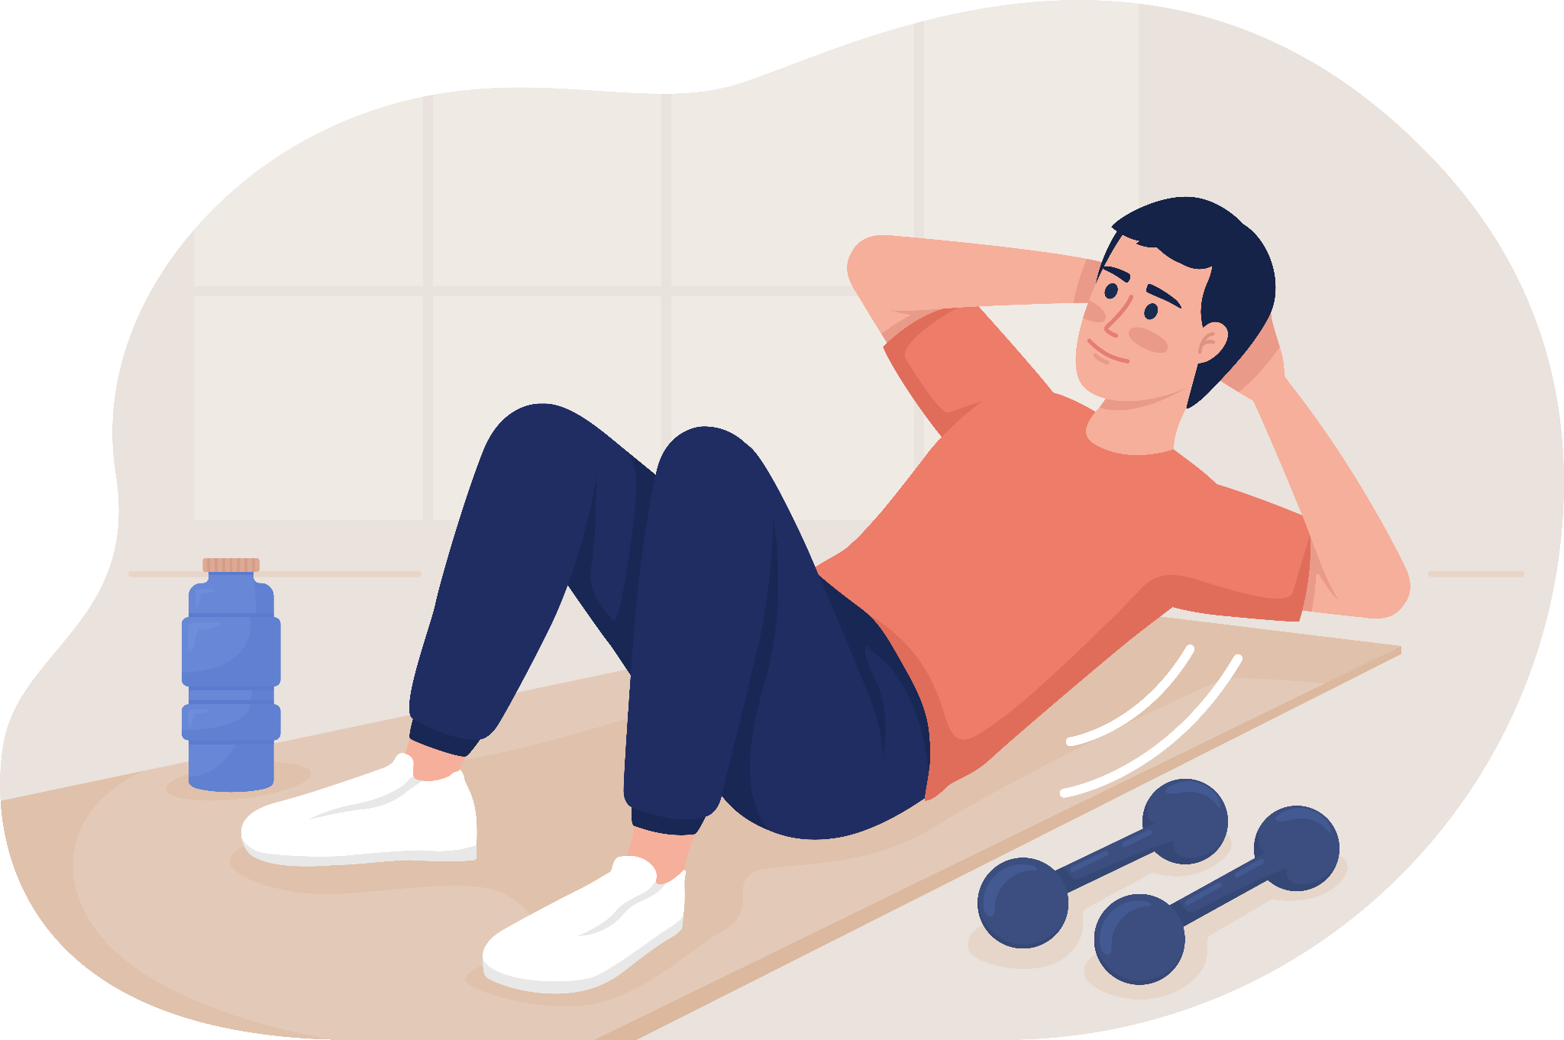
Physical Activity
Benefits of Exercise:
Lower blood pressure
Weight control
Increased insulin sensitivity
Improved lipid levels
Improved blood glucose control
Reduced risk of CVD
Prevent/delay onset of type 2 diabetes

Slide 21
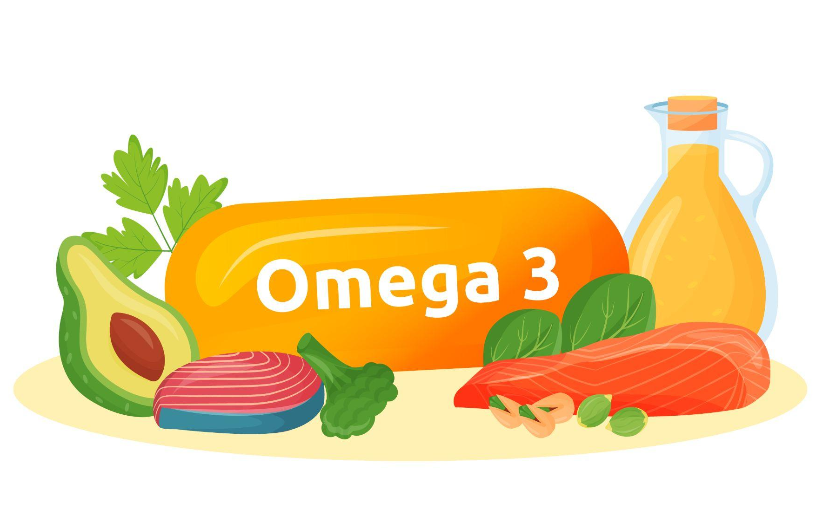
Omega-3 Fatty Acid
Omega-3 fatty acid, which is found mainly in fish, may help lower blood pressure and triglycerides, lowering the risk of heart disease.
It’s best to get omega-3s from food, so you should aim to eat fatty fish, like salmon, mackerel, and trout, at least twice a week.

Slide 22
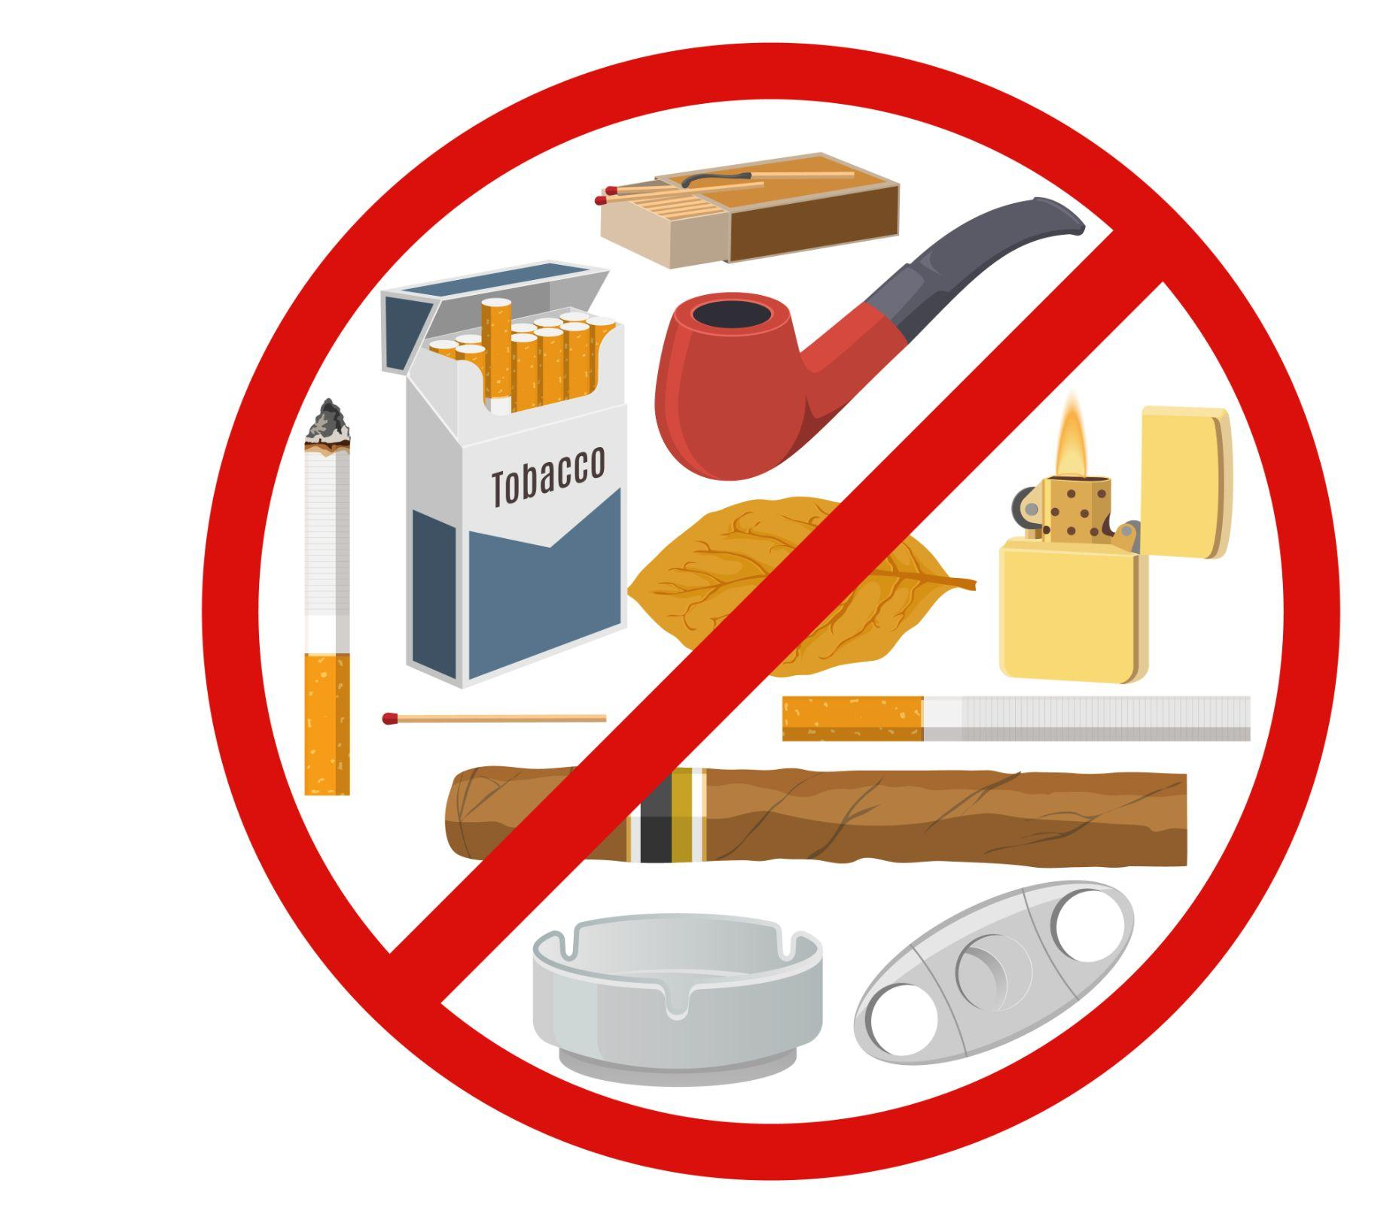
Risk Factor: Smoking
Causes plaque to form in blood vessels.
Reduces HDL (“good”) cholesterol.
Increases blood pressure.
Increases heart arrhythmias.
Risk decreases after quitting by 1/3 in 2 years.
Equal to a non-smoker in 10-14 years.

Slide 23
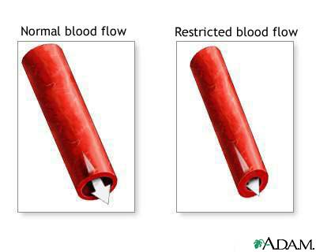
Smoking
Injures blood vessel walls.
Speeds up the process of hardening of the arteries.
Notes:
Smoking injures blood vessel walls and speeds up the process of hardening of the arteries. Smoking causes shrinking of the arteries and restricted blood flow. So even though it doesn’t cause high blood pressure it is a bad idea for anyone, especially those with high blood pressure. Once you quit, your risk of having a heart attack is reduced after one year.

Slide 24
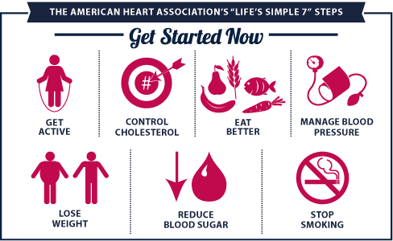
Life’s Simple 7

Slide 25
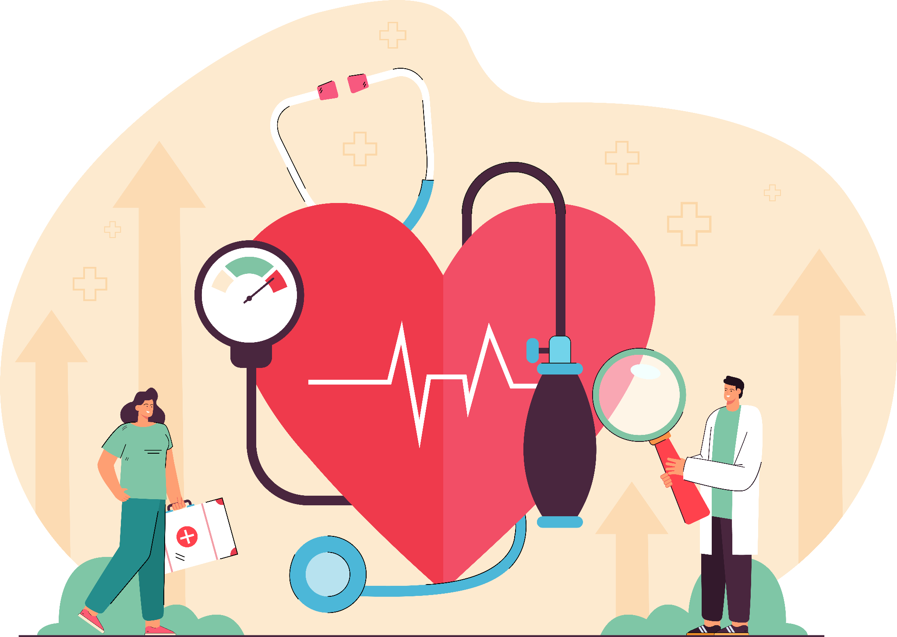
Information For Your Interest

Slide 26
Sodium Restriction
For Hypertension
Mild sodium restriction (2000-3000 mg)
Foods allowed:
Natural fresh foods, processed/preserved foods in which salt is not used as a preservative or flavoring agent
Foods omitted:
Table salt (use salt lightly in cooking)
Salt preserved foods: salted/smoked meat and fish
Highly salted foods: crackers, chips & salted nuts, popcorns and snacks
Foods with (Na) preservative: pickles, dips and sauces of tomato, chilli, garlic, soy
Flavored enhancers: Monosodium Glutamate (MSG)
Processed cheese and salted butter

Slide 27
Sodium Restriction
For Hypertension
Moderate sodium restriction (1000-1500 mg)
Foods allowed:
Above + Limit use of high Na vegetables & baked products
Moderate use of meat & milk
Foods omitted:
No salt in cooking
Canned foods in brine/canned vegetable juices
> 1 serving of these vegetables per day: carrots, beetroot and greens, mustard greens, spinach, turnips
Bread, bread roll, crackers
Ready-to-eat breakfast cereals: cornflakes, oats
Shellfish, shrimp, crab, lobster
Mayonnaise or other salad dressings
Baking powder/soda or their products

Slide 28
Sodium Restriction
For Hypertension
Severe sodium restriction (500-700 mg)
Foods omitted:
Above +
Limit use of meat/chicken (80g), eggs (1) and milk (2 cups)
Careful selection of foods in measured amounts is important.

Slide 29
Sodium Restriction
For Hypertension
Extreme sodium restriction (200-300 mg)
Foods omitted:
Above +
Limit use of milk, milk/chicken (40g/day), eggs (3/week)
Careful selection of foods in measured amounts is important.

Slide 30
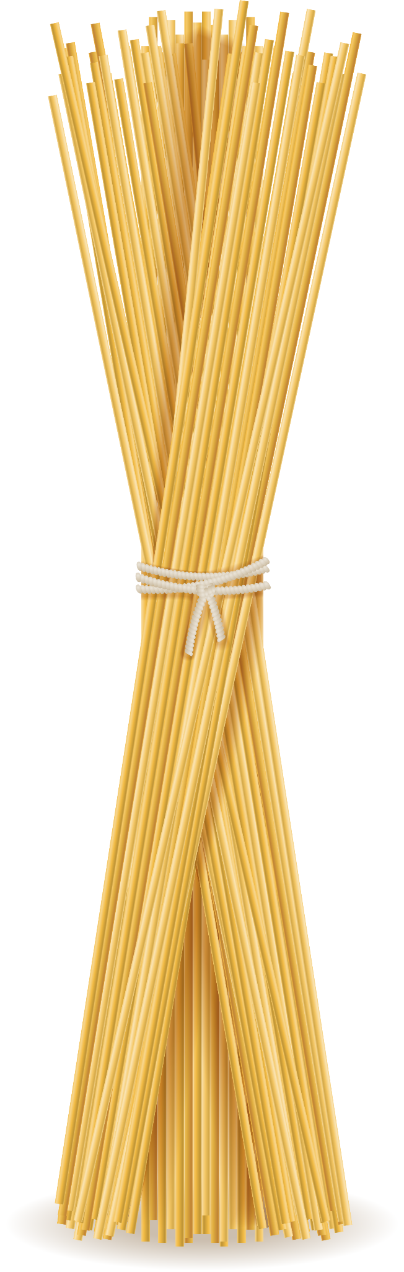
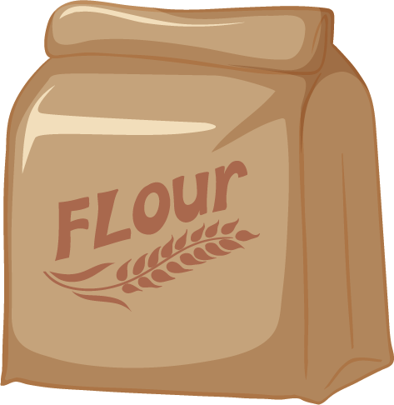
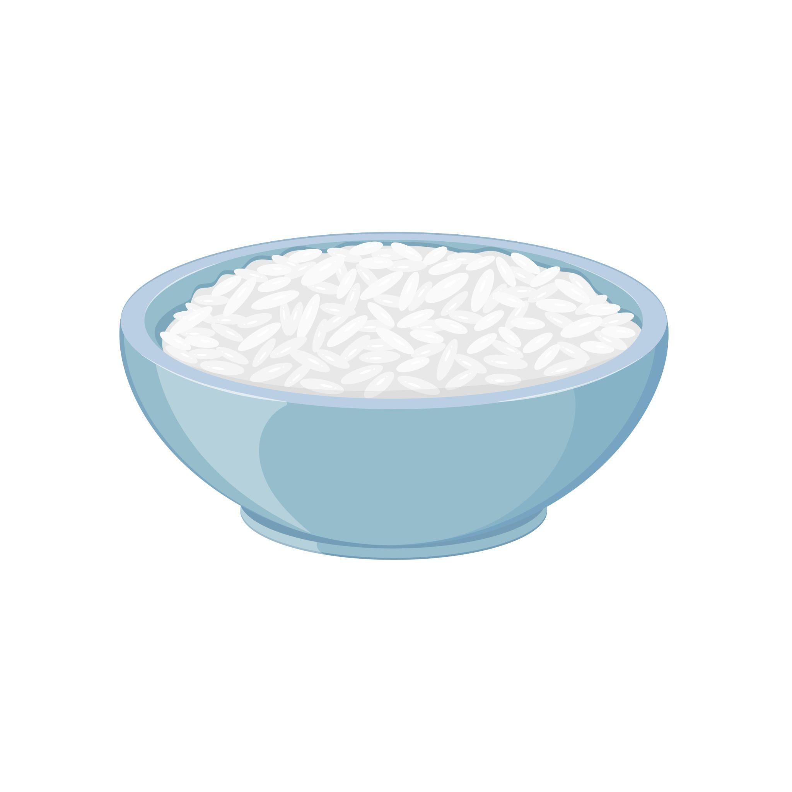
Sodium & Potassium Content (mg/100g) of Commonly Used Foods
Foods Sodium Potassium
(mg/100g) (mg/100g)
Cereals
Maize (dry) 15.9 286
Maize (tender) 51.7 151
Rice flakes 10.9 154
Wheat flour (whole) 20.0 315
Wheat flour (refined) 9.3 130
Wheat, semolina 21.0 83
Wheat, vermicelli 7.9 138

Slide 31
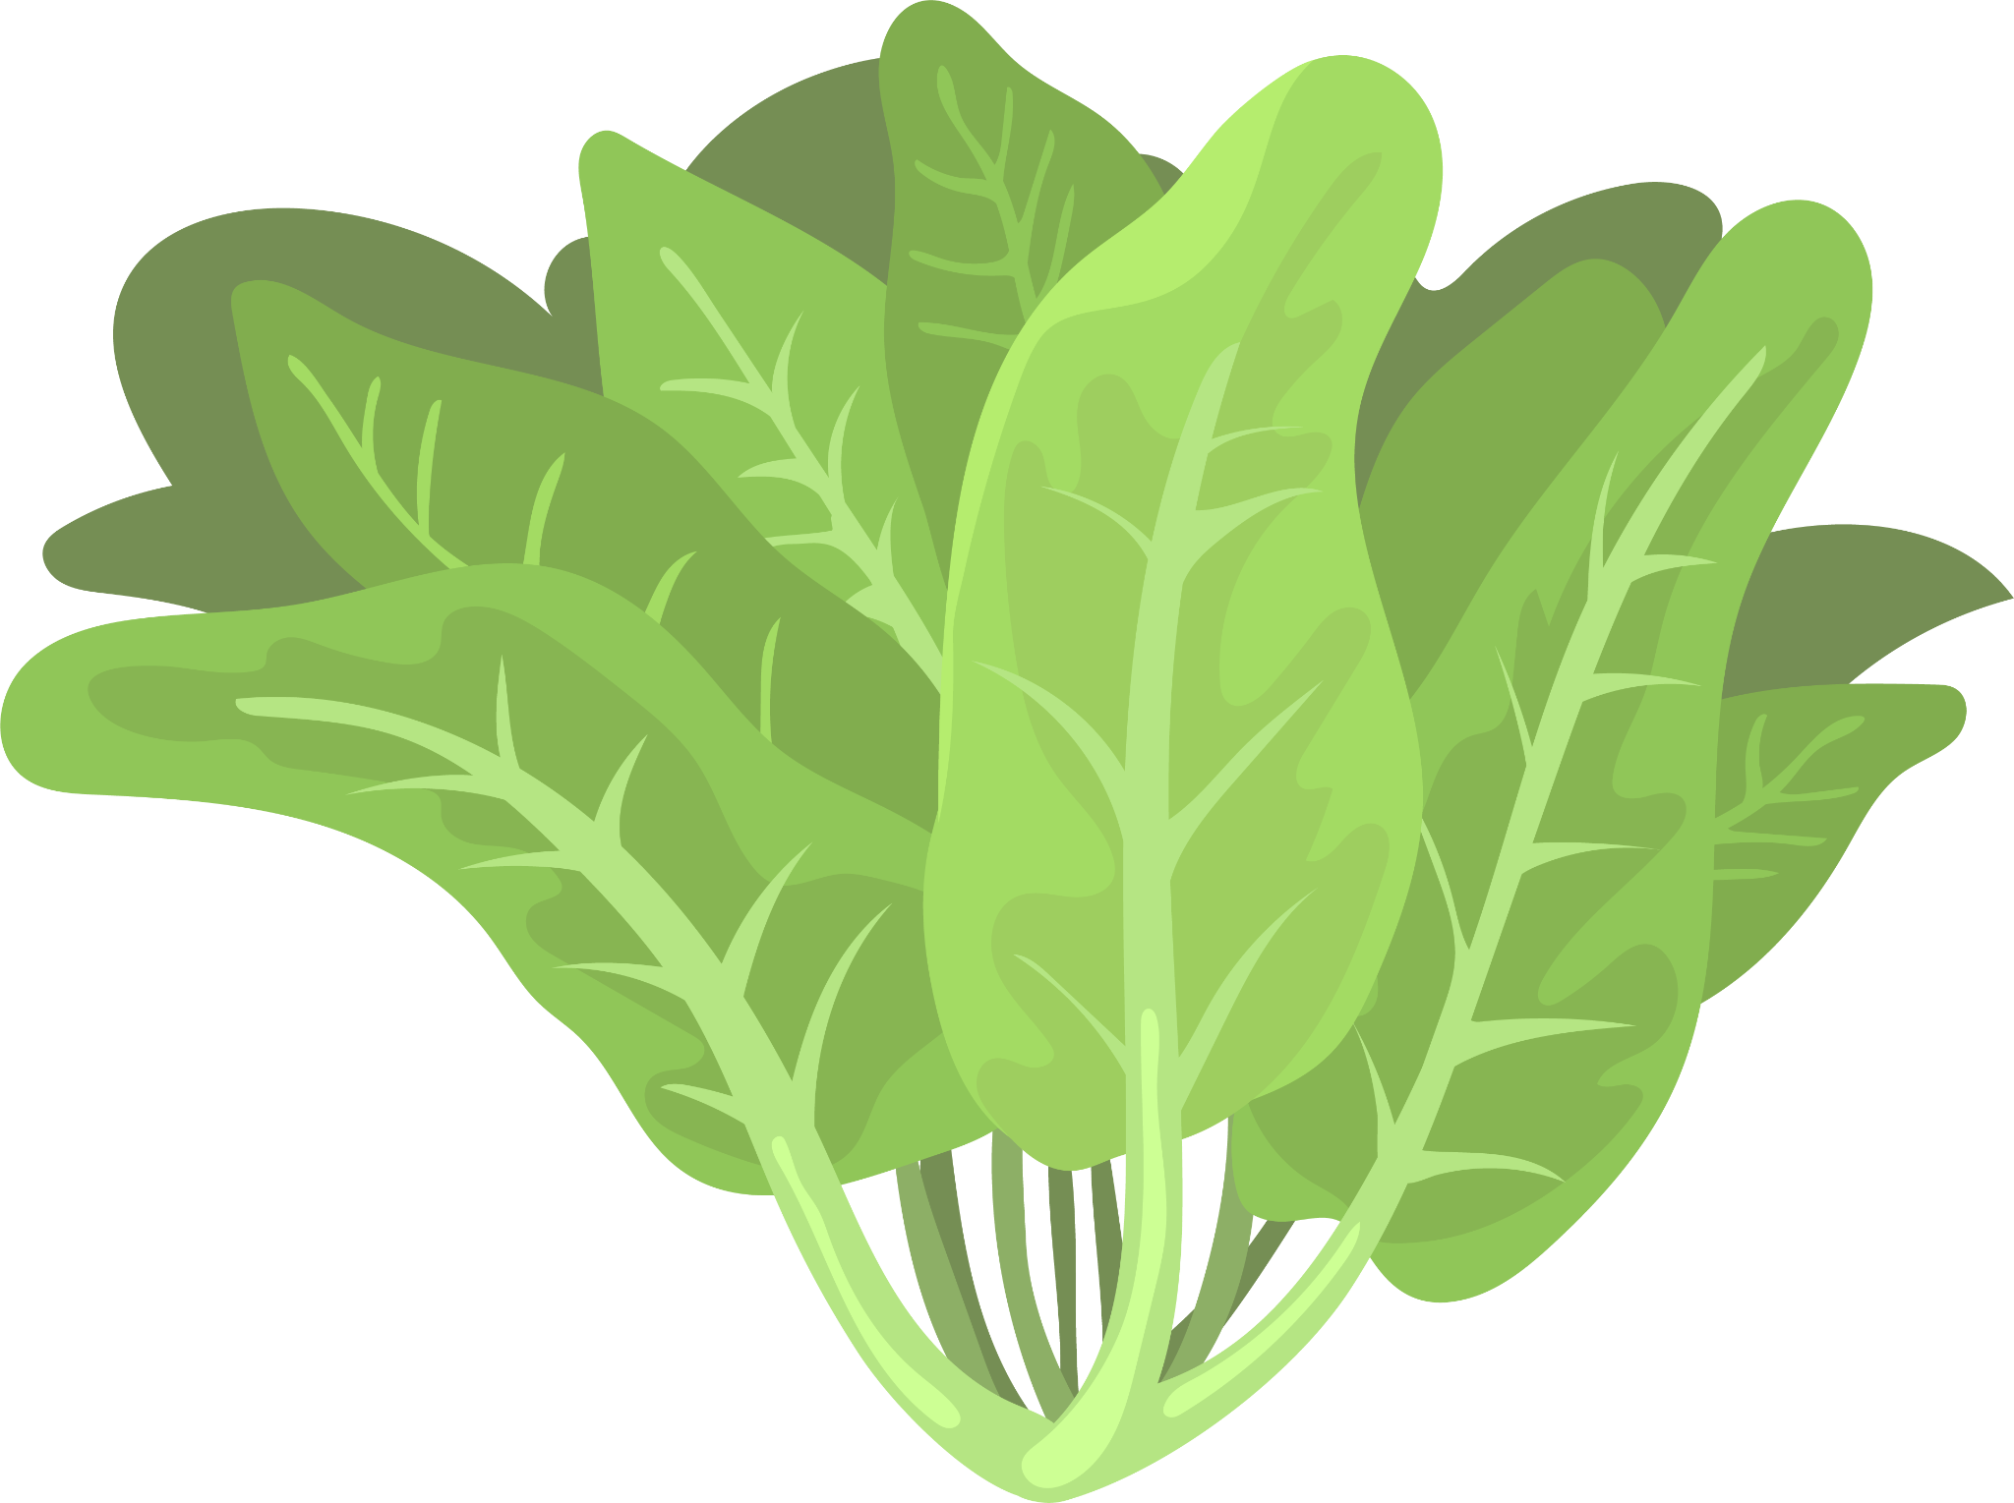
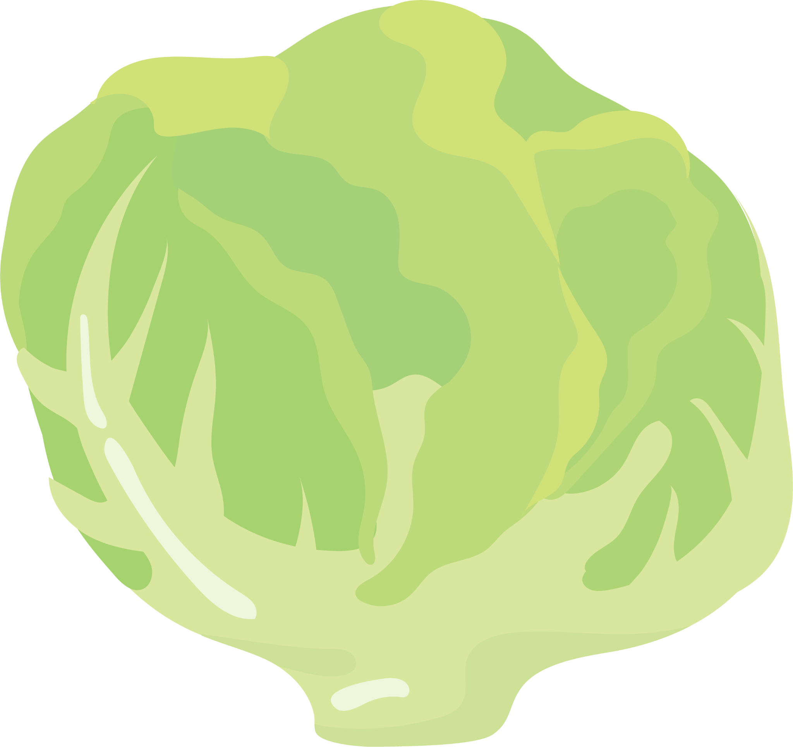
Sodium & Potassium Content (mg/100g) of Commonly Used Foods
Foods Sodium Potassium
(mg/100g) (mg/100g)
Green Leafy Vegetables
Coriander leaves 58.3 256
Fenugreek leaves 76.1 31
Lettuce 58.0 33
Spinach 58.5 206

Slide 32
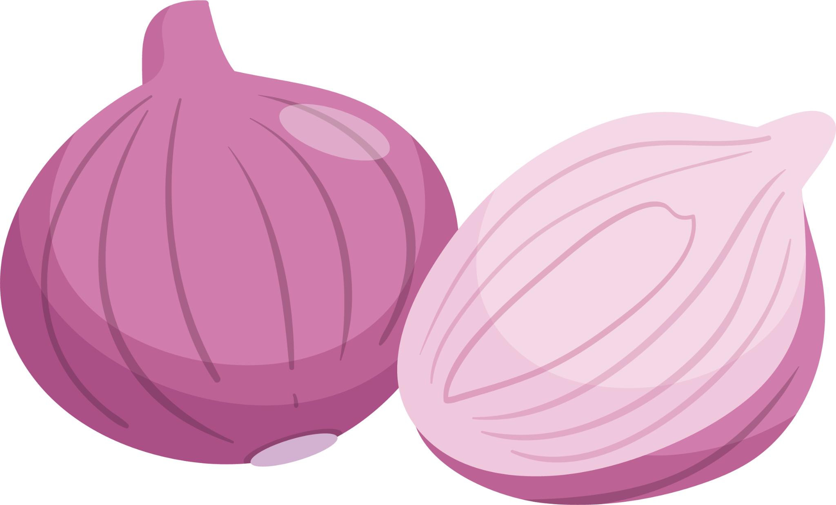
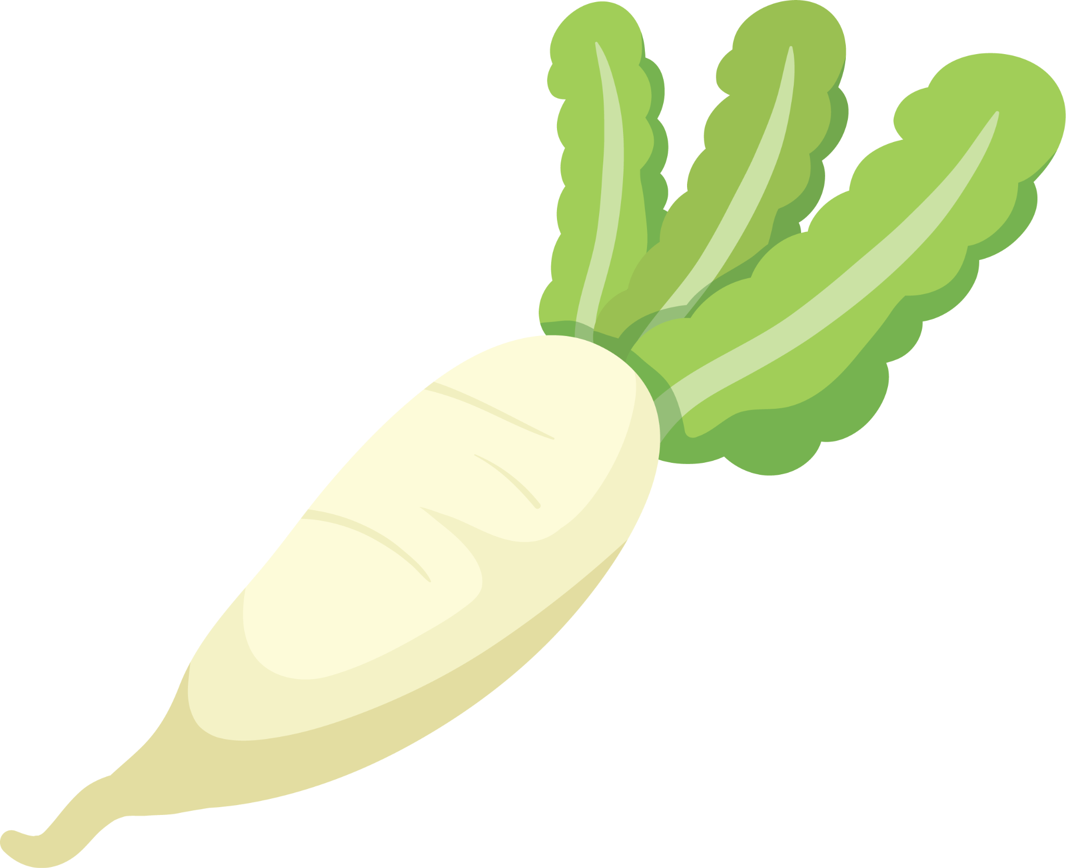


Sodium & Potassium Content (mg/100g) of Commonly Used Foods
Foods Sodium Potassium
(mg/100g) (mg/100g)
Roots and Tubers
Beetroot 59.8 43
Carrot 35.6 108
Onion (big) 4 127
Potato 11 247
Radish (pink) 63.5 10
Radish (white) 33 138
Sweet potato 9 393
Yam 9 237

Slide 33
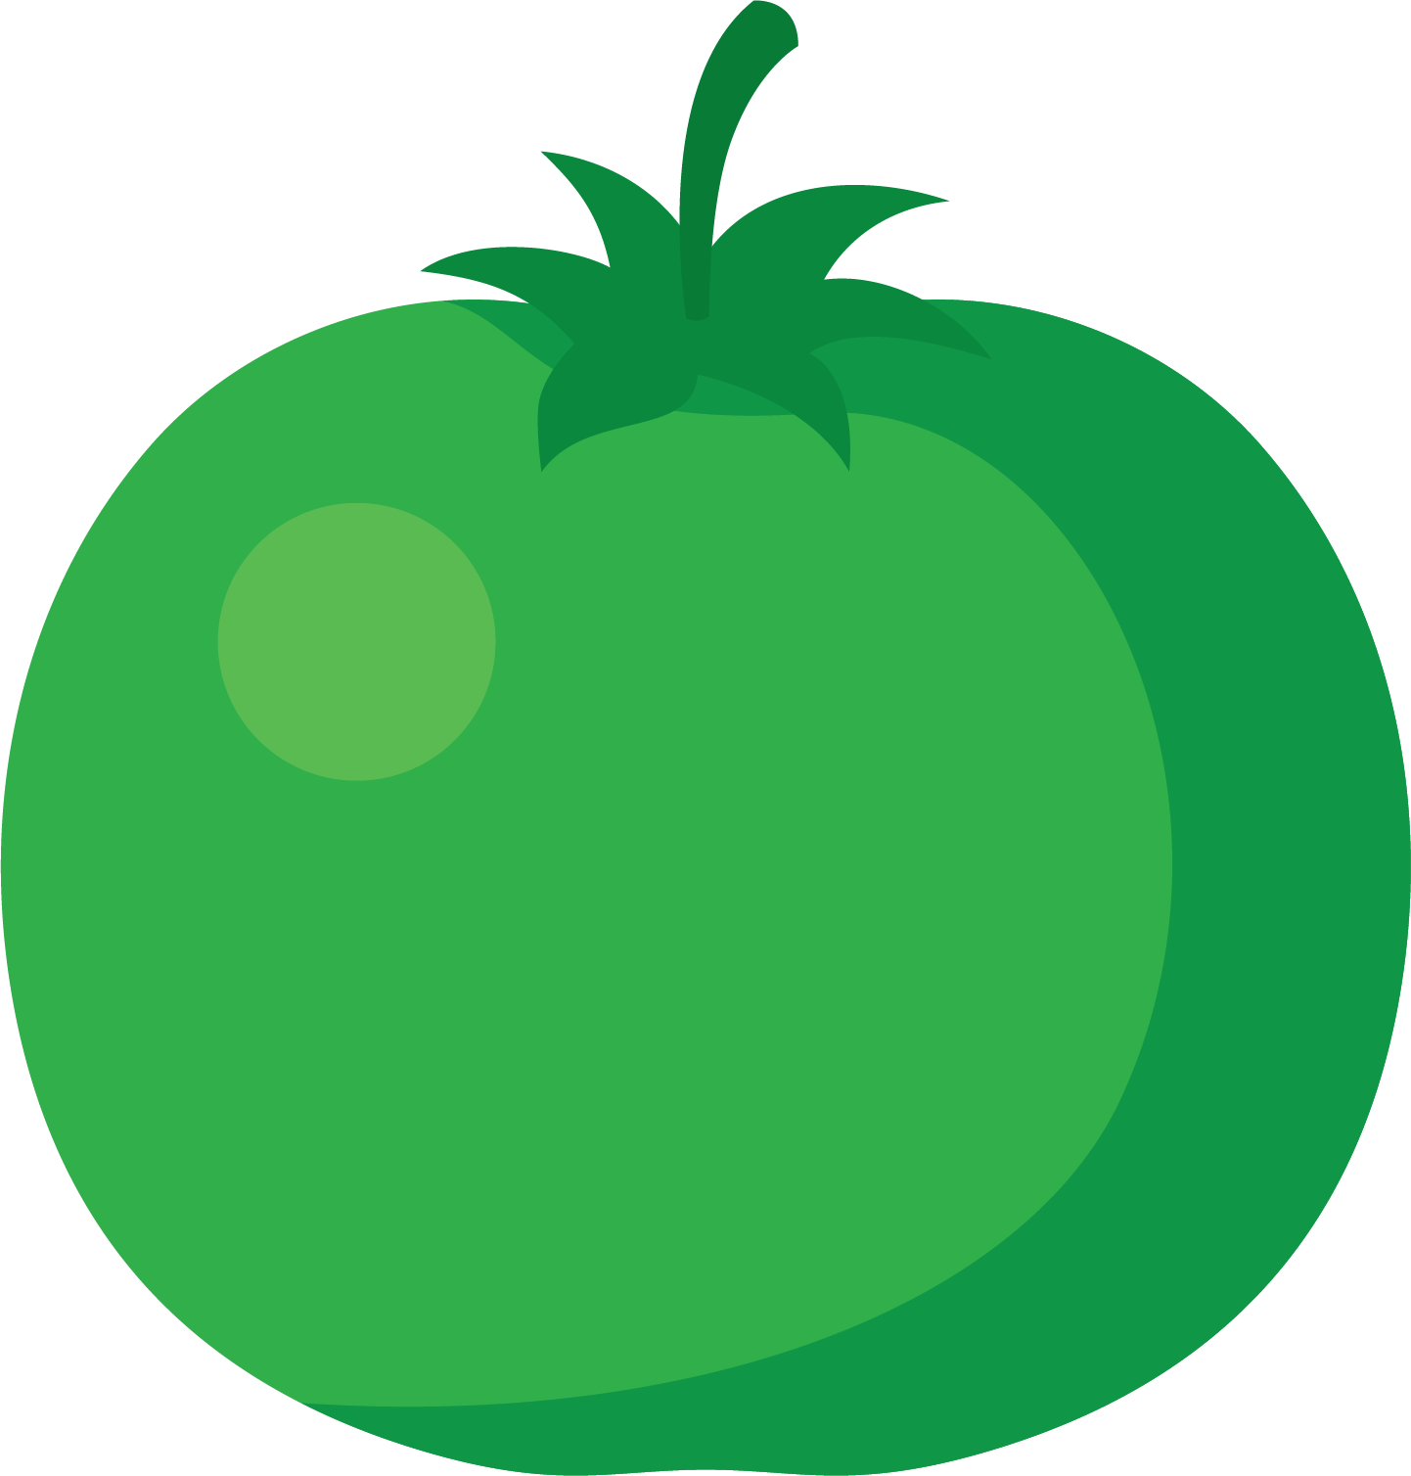
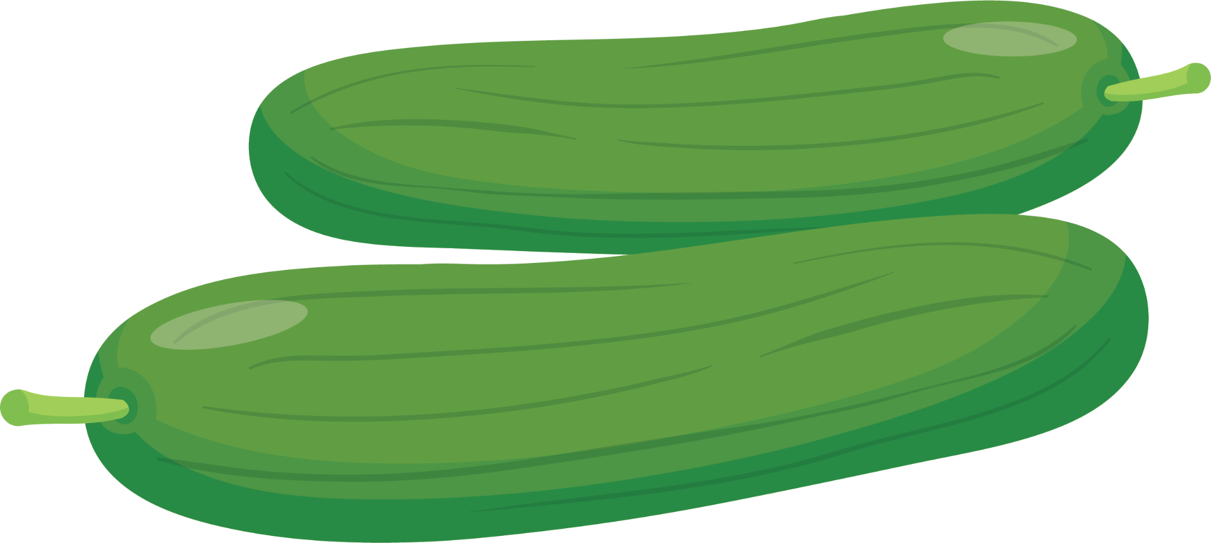
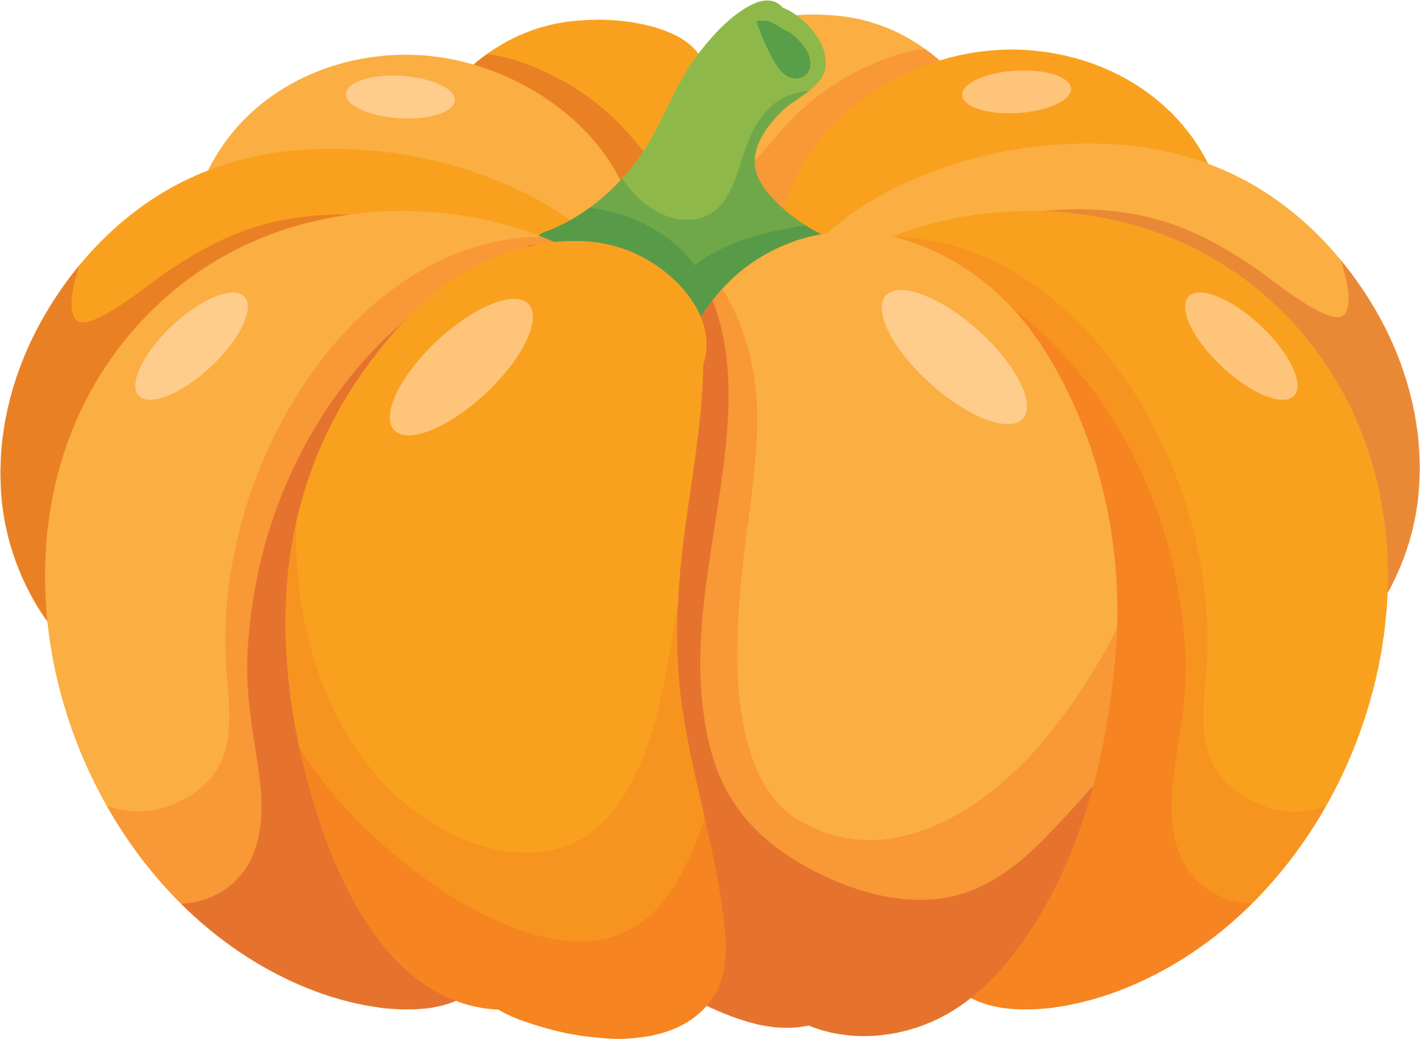
Sodium & Potassium Content (mg/100g) of Commonly Used Foods
Foods Sodium Potassium
(mg/100g) (mg/100g)
Other Vegetables
Broad beans 43.5 39
Cauliflower 53.0 138
Cucumber 10.2 50
Field beans 55.4 74
French beans 4.3 120
Ladies finger 6.9 103
Pumpkin 5.6 139
Tomato, green 45.8 114

Slide 34

Sodium & Potassium Content (mg/100g) of Commonly Used Foods
Foods Sodium Potassium
(mg/100g) (mg/100g)
Pulses
Lentil, whole 40.1 629
Peas, green 7.8 79
Red gram dal 28.5 1104

Slide 35
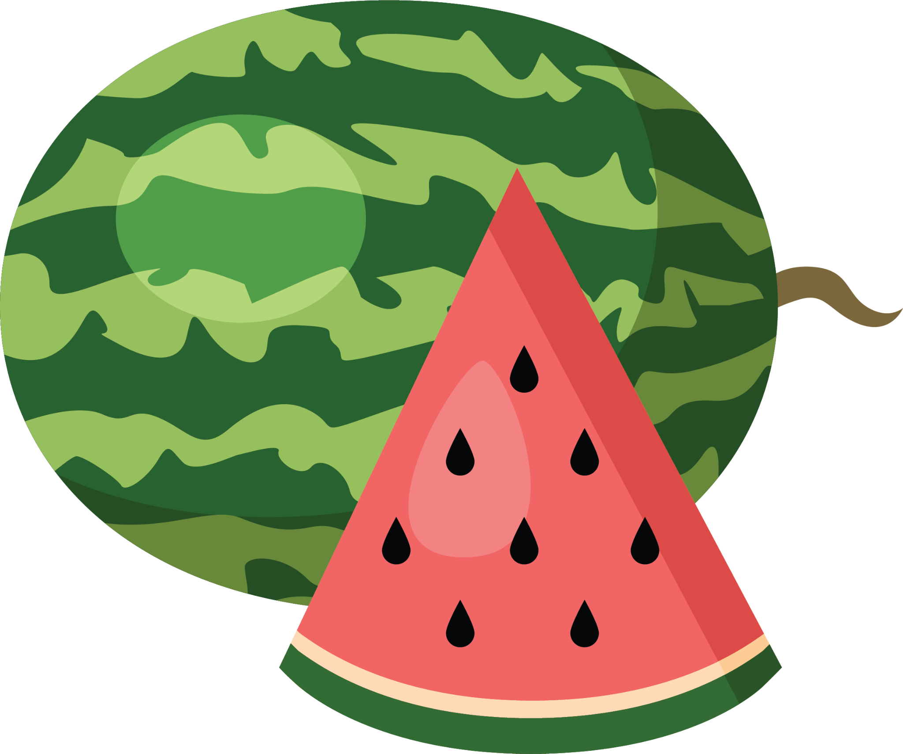


Sodium & Potassium Content (mg/100g) of Commonly Used Foods
Foods Sodium Potassium
(mg/100g) (mg/100g)
Fruits
Apple 28 75
Banana 36.6 88
Guava 5.5 91
Mango 26 205
Melon, musk 104.6 341
Melon, water 27.3 160
Orange 4.5 9.3

Slide 36

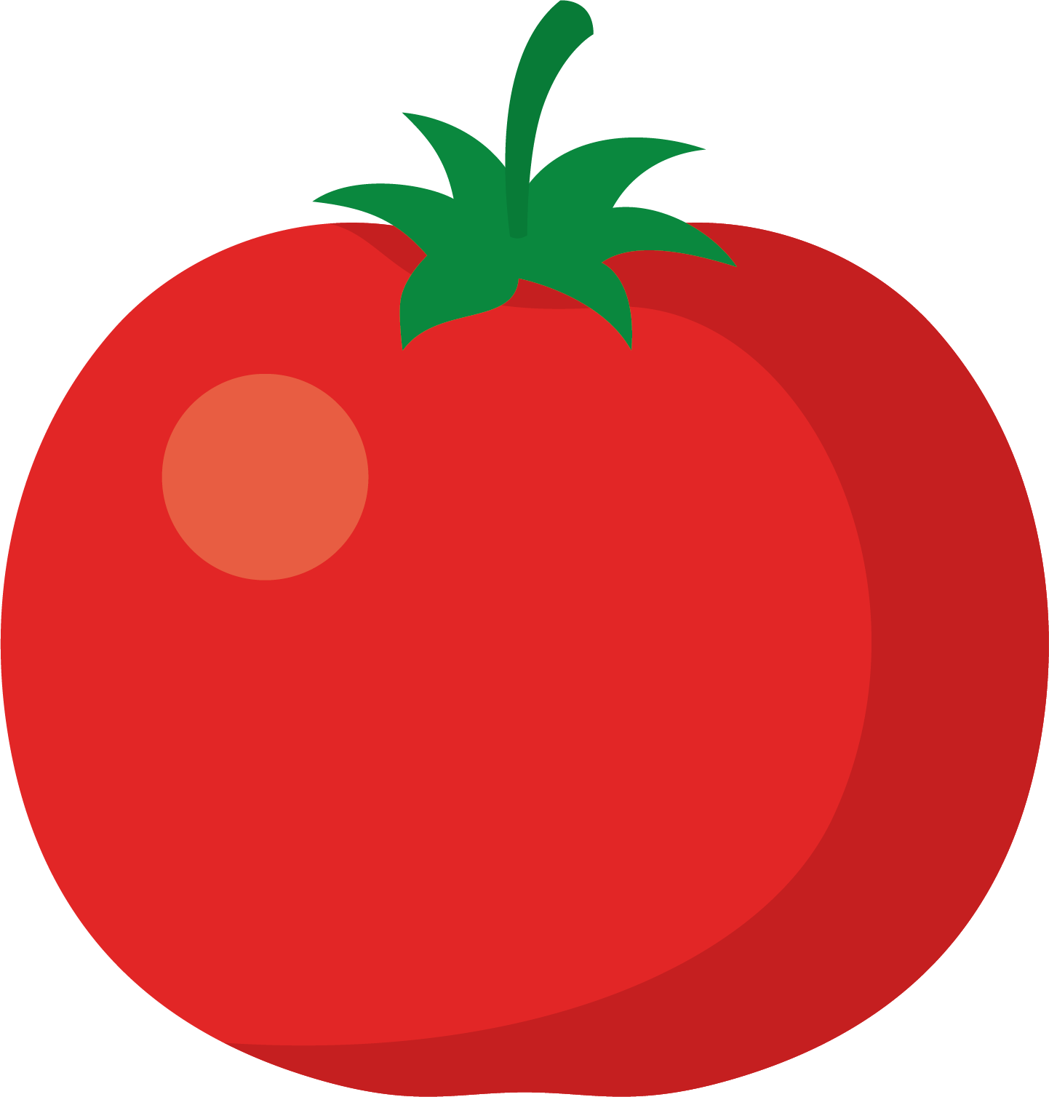

Sodium & Potassium Content (mg/100g) of Commonly Used Foods
Foods Sodium Potassium
(mg/100g) (mg/100g)
Fruits
Papaya 6 69
Peaches 2 453
Pears 6.1 96
Pineapple 34.7 37
Plums 0.8 247
Pomegranate 0.9 133
Tomato, ripe 12.9 146

Slide 37

Sodium & Potassium Content (mg/100g) of Commonly Used Foods
Foods Sodium Potassium
(mg/100g) (mg/100g)
Fish and Other Sea Foods
Bhekti fish 66 173
Prawn 66 262
Rohu 101 288

Slide 38

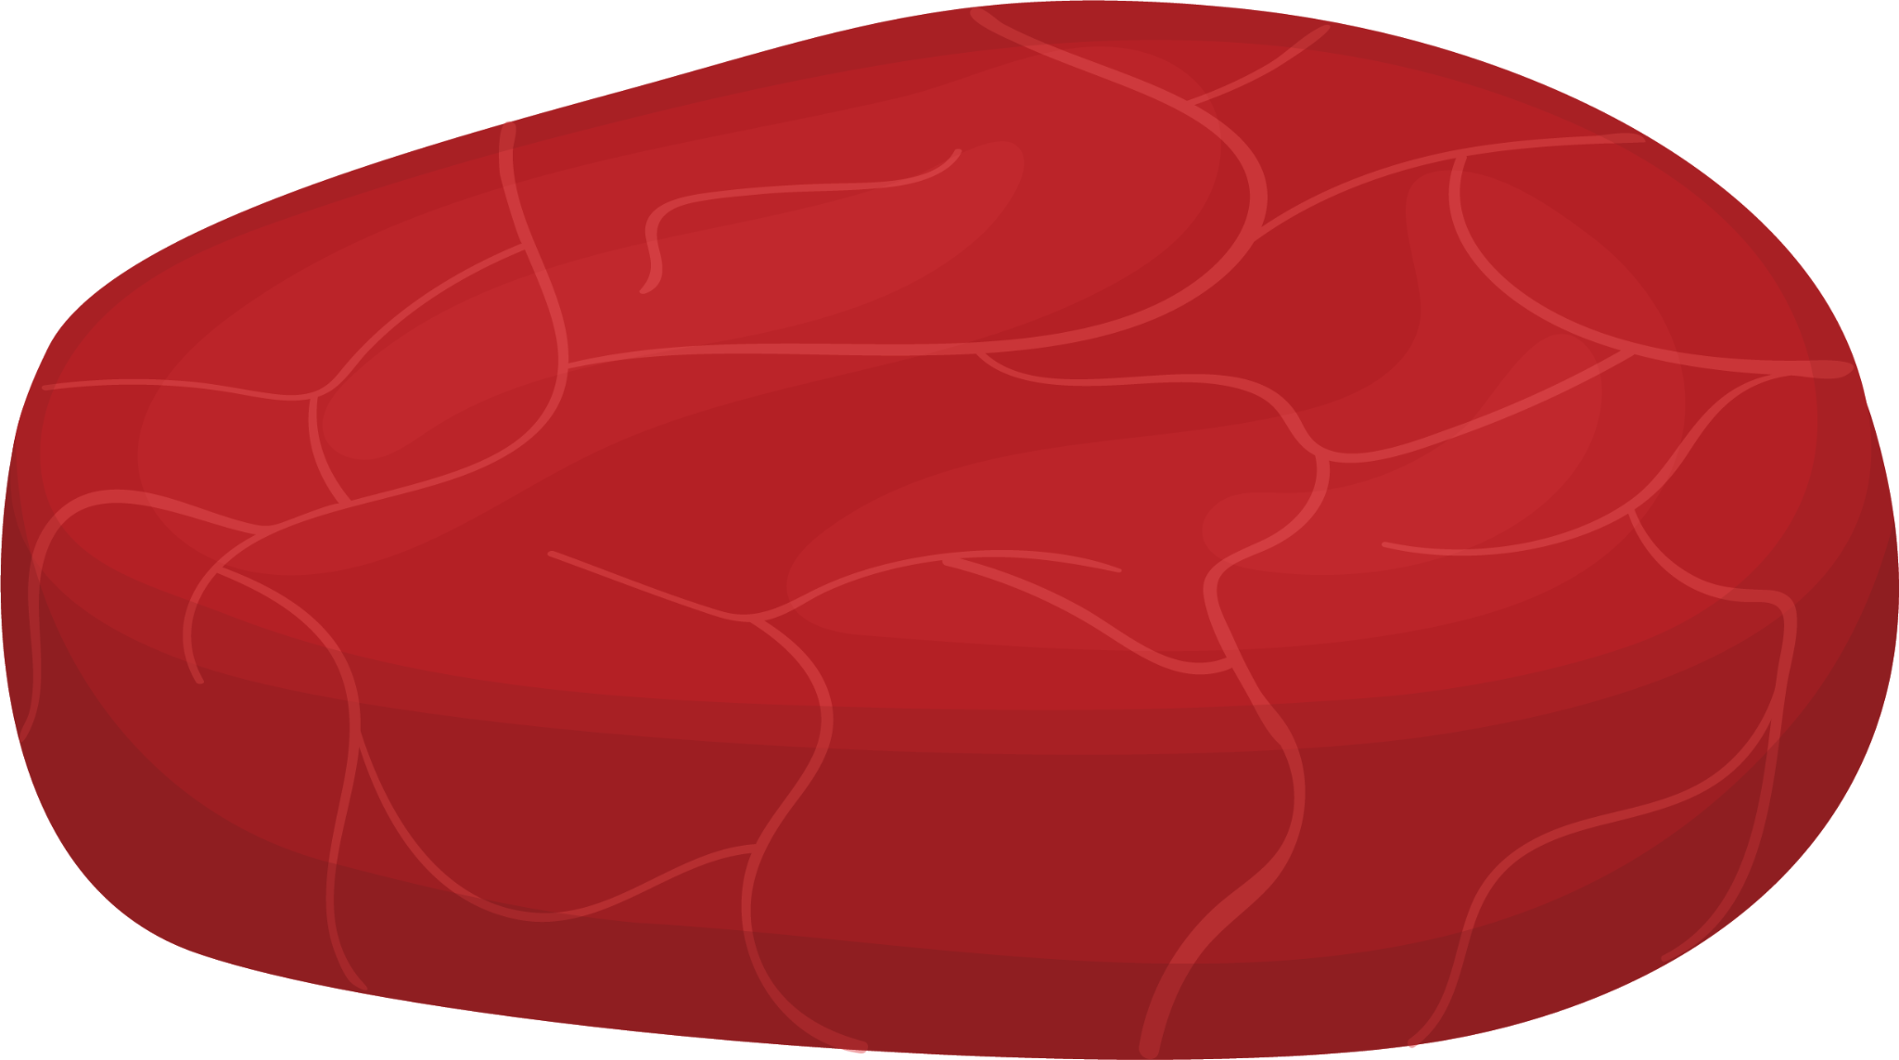
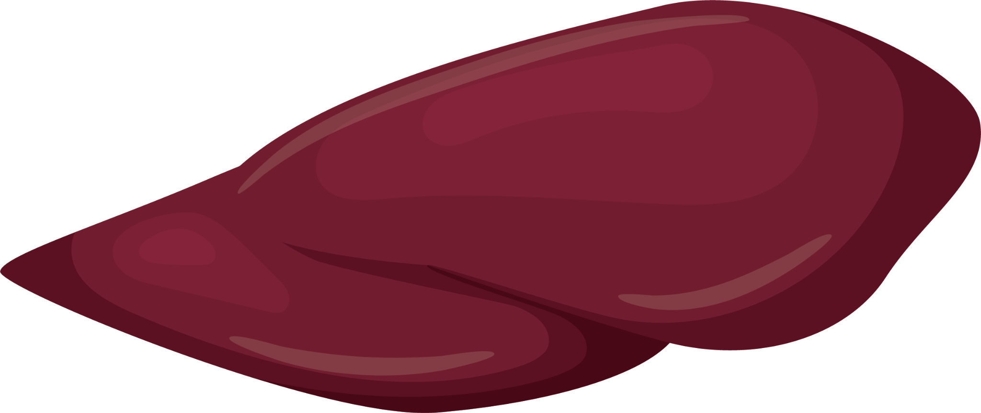
Sodium & Potassium Content (mg/100g) of Commonly Used Foods
Foods Sodium Potassium
(mg/100g) (mg/100g)
Meat and Poultry
Beef muscle 52 214
Egg 50 65
Liver 73 160
Mutton, muscle 33 270

Slide 39

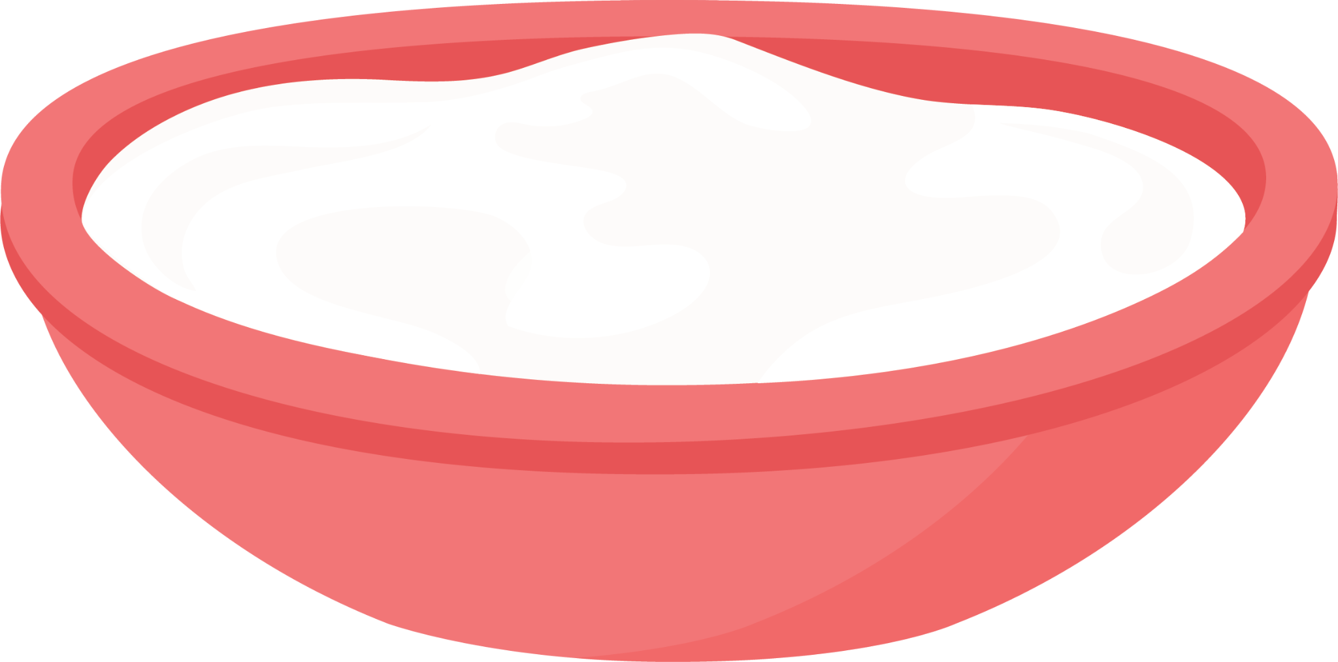

Sodium & Potassium Content (mg/100g) of Commonly Used Foods
Foods Sodium Potassium
(mg/100g) (mg/100g)
Milk and Other Products
Milk, buffalo 19 90
Milk, cow 73 140
Milk, goat 11 110
Curd, cow 32 130
Cottage cheese 400 75

